Slide 1
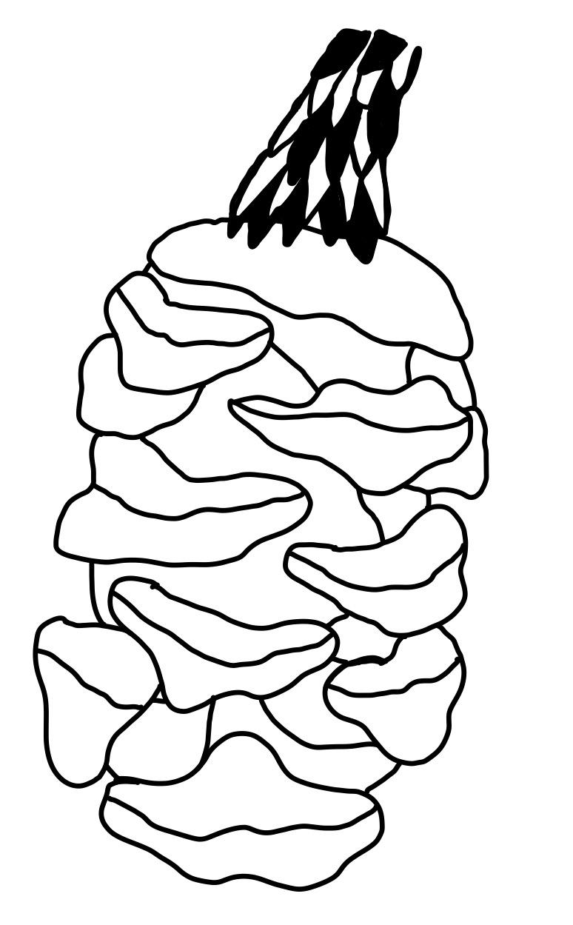
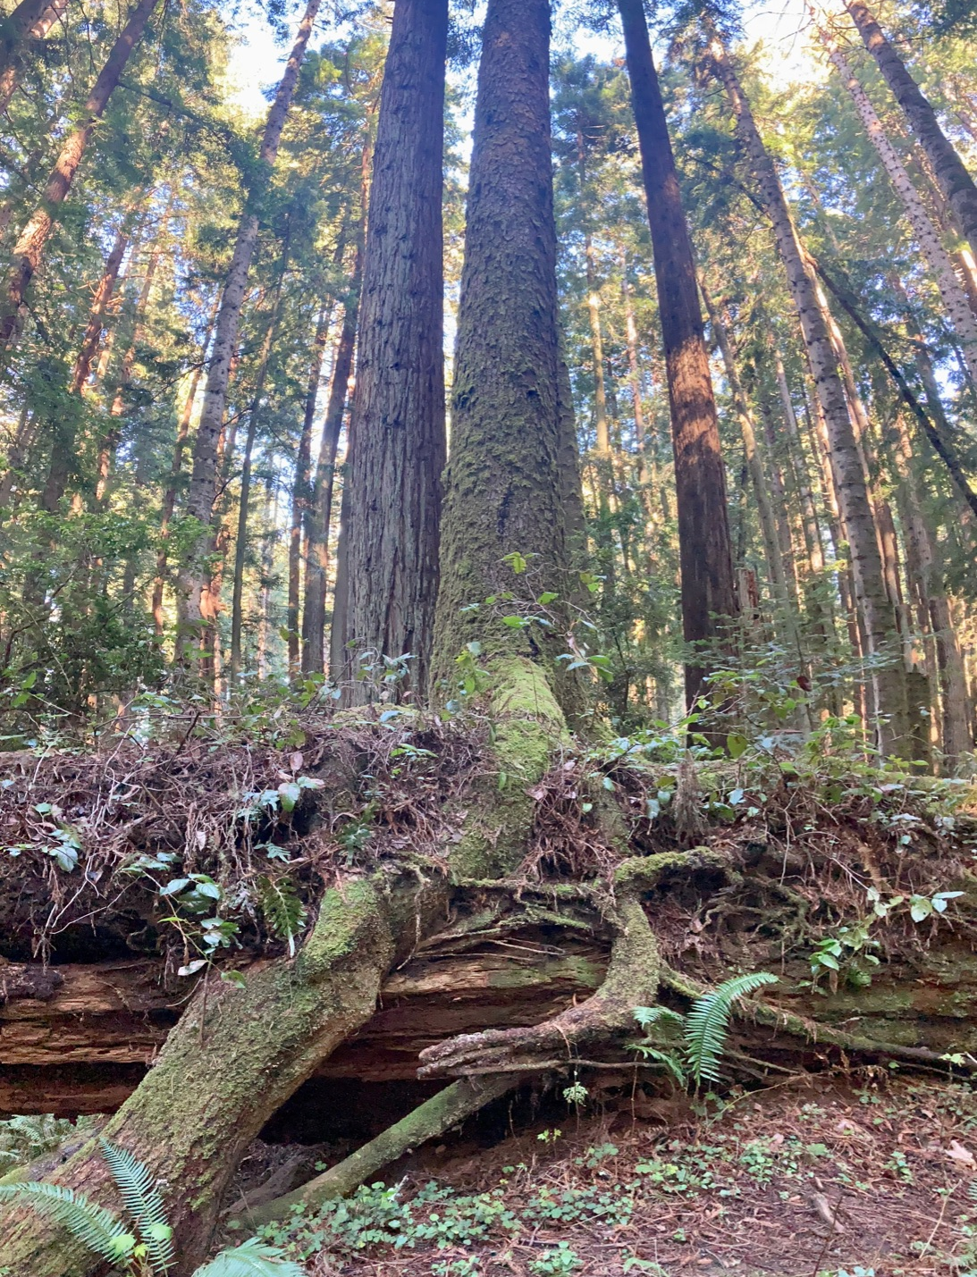
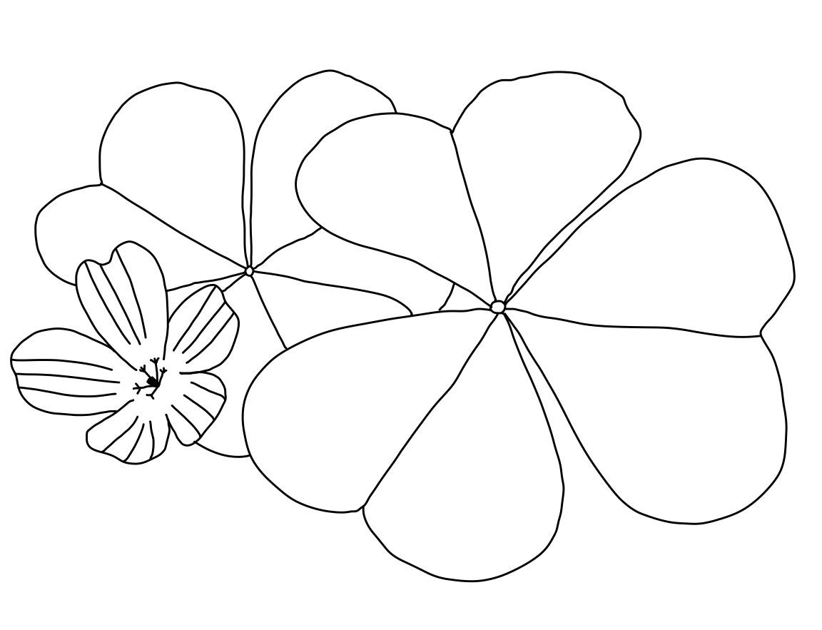
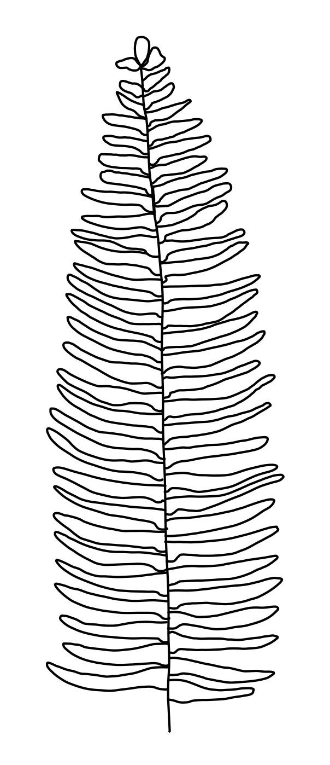
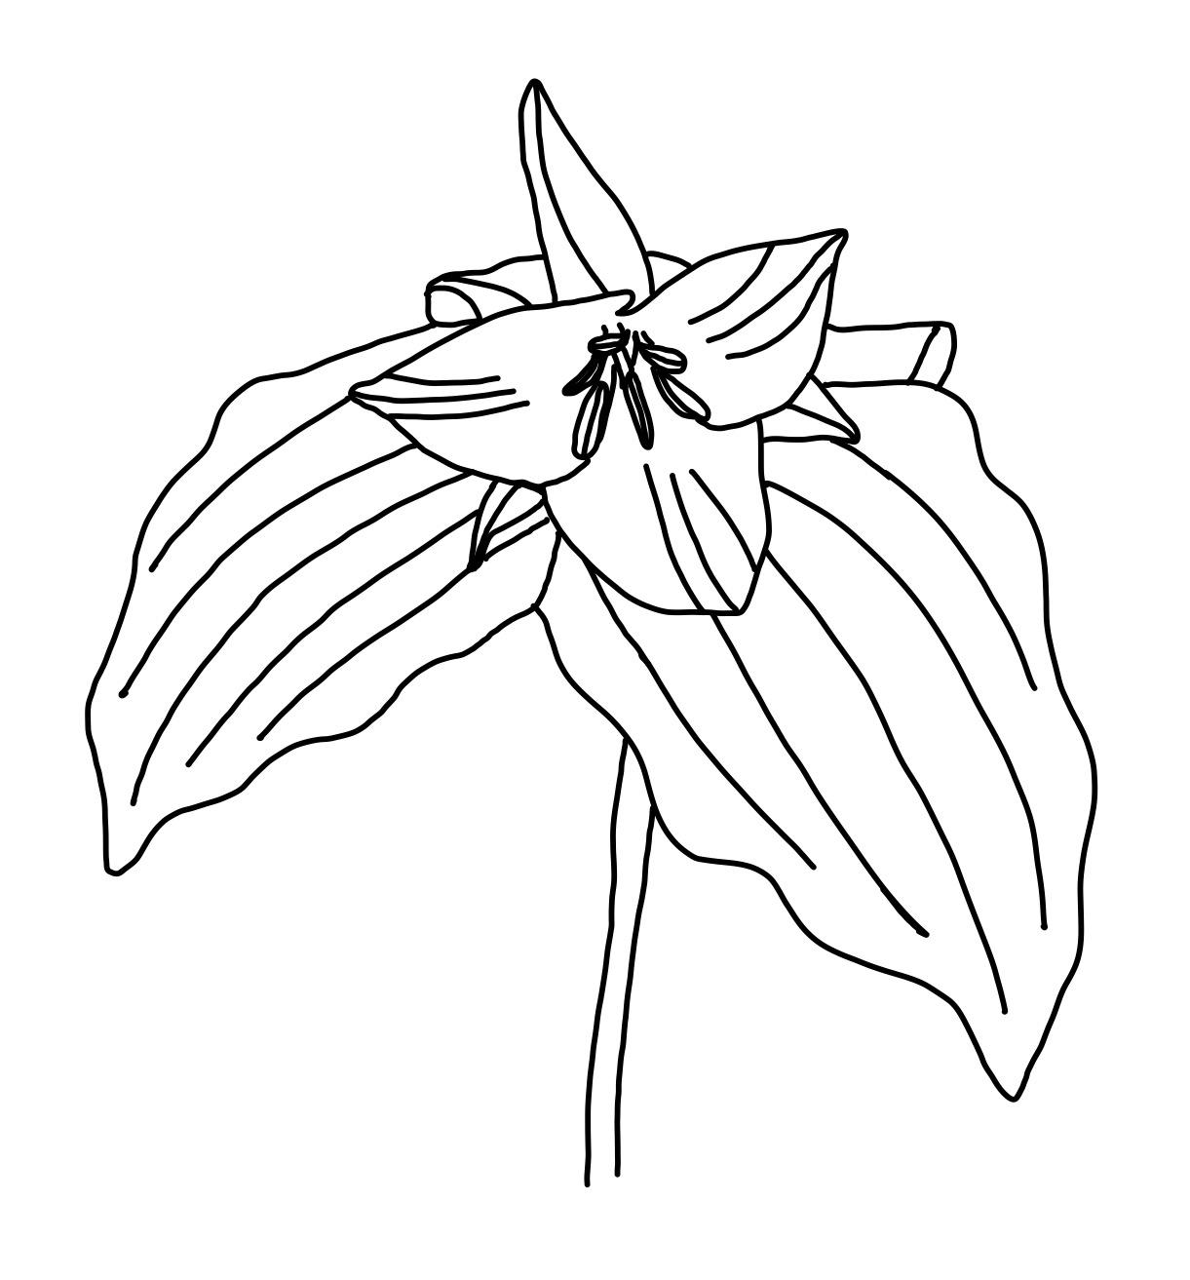
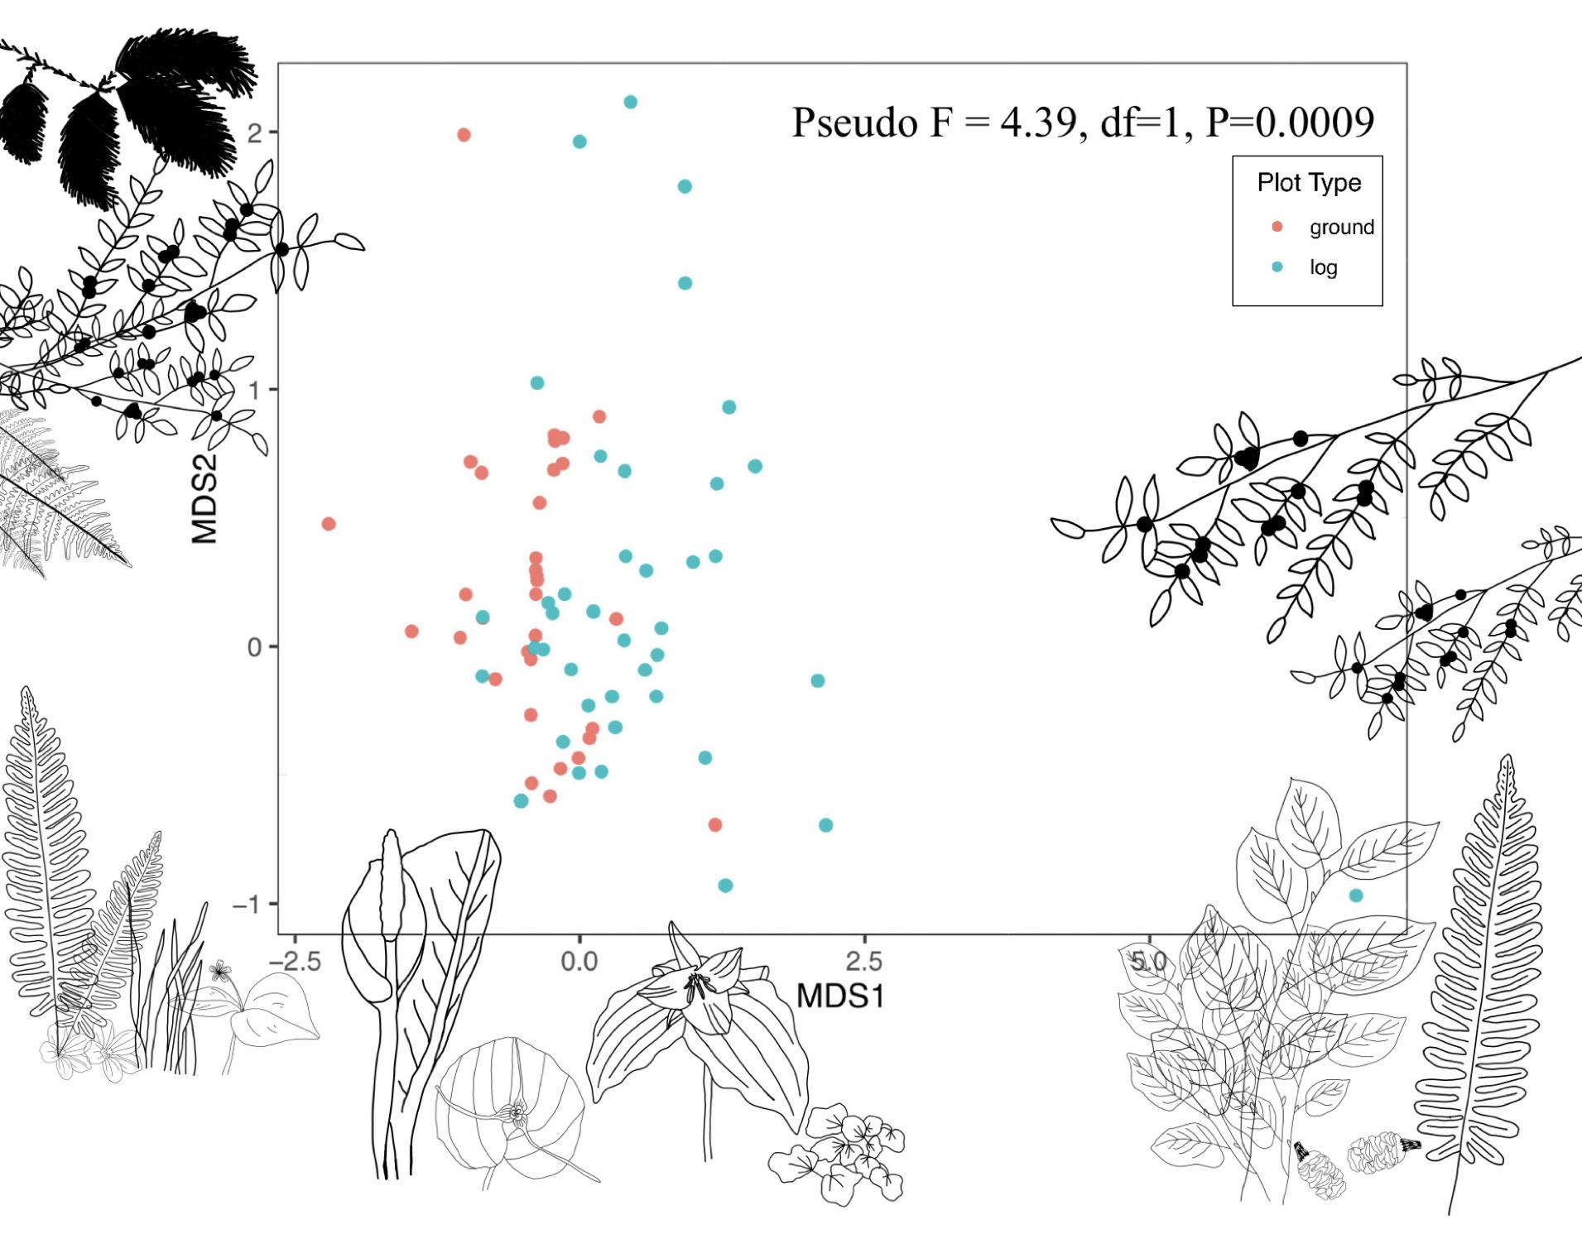
Comparing Community Structure of Vascular Plant Species on Nurse Logs and Ground Plots in the Arcata Community Forest
Isabella H. Norton
Department of Wildlife Management and Conservation
INTRODUCTION
Fallen trees, or nurse logs, are important features in forest ecosystems that can provide diverse wildlife habitat, substrate for vascular and nonvascular plants, and be a crucial mechanism in energy flow and nutrient cycling (Harmon et al. 1986).
Sustainable forest management has been a growing focus of recent decades in the Pacific Northwest redwood forests, and nurse logs could be an important tool in maintaining these healthy stands (Andre 2015).
I hypothesized that nurse logs were an important feature that should be included in healthy forest management because they promoted vascular plant heterogeneity in the forest habitat.
RESULTS
Based on my MDS and PERMANOVA analysis, vascular plant communities differed on logs and the ground (Pseudo-F_{1,105} = 4.39, P = 0.0009).
I found that species richness did not differ significantly between log and ground plots (t₅₄ = 0.21, P = 0.83). I also determined that total plant coverage and abundance was not significantly different between log and ground plots (t₅₄ = 1.24, P = 0.22 & t₅₄ = 1.98, P = 0.052).
LOG
DISCUSSION
Simple metrics analysis did not show a significant difference between ground and log plots in terms of species richness, plant coverage, or abundance. I did find a difference, however, in the overall structures of vascular plant communities on logs and the ground through further analysis.
My hypothesis was supported that logs are home to a different habitat compared to the floor of the redwood forest. Logs provided a different habitat in the ecosystem, with potentially different substrate characteristics, light levels, less competition, and protection from herbivores (Harmon et al. 1986). I would recommend that some downed logs are left on the forest floor to promote health and heterogeneity in our forest.
GROUND
METHODS
I gathered data hiking along the trails in the Arcata Community Forest, located in Humboldt County, CA during the months of February to March 2022. I used a half meter quadrat on log and ground plots where I recorded data on all species present, number of individuals, and percent of cover for each species. For logs I also collected diameter and length measurements. Ground plots were located 1 meter away from the center of the logs.
I conducted paired t-tests to compare the species richness, abundance, and plant coverage between ground and log plots. I also did an MDS and PERMANOVA analysis to address the differences in community structure between plots.
Community Composition on Logs and Ground
Figure 1: Vascular plant community structures differed between ground and log plots. Drawings correspond to the 4 most common species found on that axis.
LITERATURE CITED
Andre, M. S. 2015. Arcata Community Forest, California, United States of America. Pages 53-59 in Forest Plans of North America. Academic Press.
Harmon M. E., J. F. Franklin, F. J. Swanson, P. Sollins, S. V. Gregory, J. D. Lattin, N. H. Anderson, S. P. Cline, N. G. Aumen, J.R. Sedell, G. W. Lienkaemper, K. Cromack, and K. W. Cummins. 1986. Ecology of coarse woody debris in temperate ecosystems. Advances in Ecological Research 15:133-276.
ACKNOWLEDGMENTS
My Humboldt State teachers, the Wildlife Stock Room, my senior project advisor Sean Mahoney, my friends Kyle, Aaron, Ruth, Zara, and my mom who came with me to collect data. And to the Redwood Forest.

