Slide 1




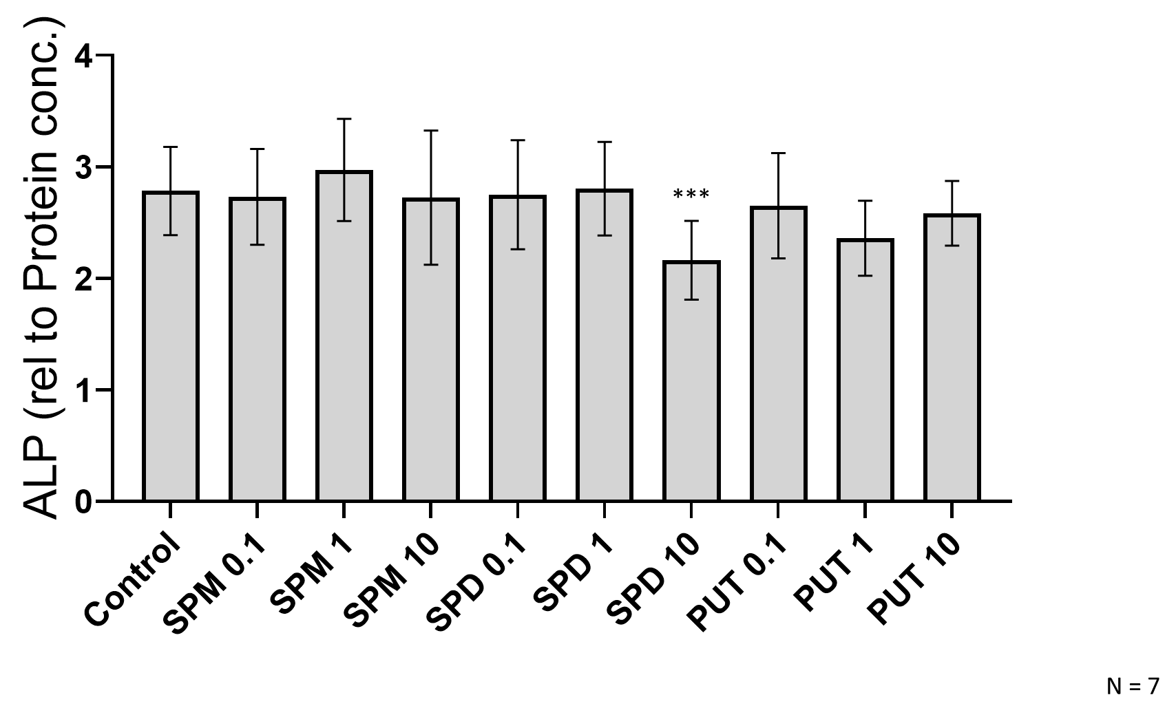





Reducing polyamine levels favors osteogenic differentiation of MSCs
Institute for Regenerative Cures
David Morales, Amin Cressman, Fernando Fierro¹
¹ Department of Cell Biology and Human Anatomy, Davis, CA 95616, USA
Snyder-Robinson Syndrome (SRS) is a rare disorder that is characterized by skeletal defects due to severe osteoporosis. SRS is caused by a mutation in the gene coding for Spermine Synthase (SMS). SMS converts spermidine into spermine via an electrophilic addition. Much still needs to be elucidated about polyamines, especially their roles in osteogenesis. In this study specifically spermidine, promotes osteogenesis. During osteo differentiation it is shown that Spermidine/Spermine Acetyltransferase (SSAT1) is upregulated, further suggesting polyamine depletion is necessary for osteogenesis. This data indicates that a reduction of polyamines is necessary for osteo differentiation.
Osteogenic differentiation in vitro:
MSCs were placed into 12-well plates with a concentration of 50,000 cells/well. The next day, medium was changed to osteogenic media (MEM-α + 10% FBS with 0.2 mM ascorbic acid, 0.1 μM dexamethasone, and 10 mM β-glycerolphosphate) with medium changes every 3–4 days.
RNA purification and amplification:
RNA was isolated using the Direct-zol RNA Mini-Prep kit by following the instructions from the manufacturer. For cDNA synthesis, the Taqman Reverse Transcription kit was used as described by the manufacturer. Real time PCR was performed using Taqman gene expression assays (Thermo Fisher) and Taqman Universal Master Mix reagents. The primers used are for GAPDH and SAT1.
Proliferation assays:
MSCs were exposed to inhibitors at 10 μM for 6 days. A cell count was conducted using a hemocytometer at days 0, 2, 4 and 6.
Osteoblast activity assays:
At day 14, osteoblast activity was quantified by measuring alkaline phosphatase (ALP) levels. In brief, cells were detached with Trypsin, centrifuged at 15000 × g , then placed in ALP buffer and vortexed. Afterward the cells were placed in a shaker on ice for 20 minutes, centrifuged again, and the supernatant collected. ALP activity was measured by reading the optic density of the solution with pNPP using a plate reader at 405 nm. Protein concentration was quantified using Coomassie stain and read at 595 nm. Osteoblast activity is measured by the ALP / protein ratio.
0
Abstract
Methods
SRS is a rare disorder that is caused by an X-linked mutation which has a dysfunctional Sms gene (Ramsay 2019). Sms encodes for Spermine Synthase (SMS), an aminopropyl transferase that catalyzes the conversion of spermidine into spermine (Lee 2010). There seems to be variation in severity of the disorder. This may be due to SMS being more functional in different individuals. An observed consequence of this disorder is an imbalance in spermidine and spermine ratio (Shwartz 1993). As less spermine is produced, spermidine becomes more abundant. The pathological mechanism of this imbalance is still not well known.
To explore how polyamines effect osteogenic differentiation we inhibited and silenced key enzymes in the biochemical pathway. Silencing was achieved as previously described by Ramsey et al, with shSMS. Inhibition was with cyclohexyl-1,3-diaminopropane (CDAP) and difluoromethylornithine (DFMO. CDAP inhibits SMS. DFMO inhibits Ornithine Decarboxylase (ODC) which produces putrescene, the main polyamine butyl moiety. Inhibition at this level halts the polyamine pathway, reducing spermidine and spermine levels.
Introduction
Figure 5. ALP from inhibited MSCs. Values are ratios of ALP activity relative to protein concentration (n = 8)
Figure 6. MSCs exposed to inhibitors at 10 μM. Cell counts conducted on days 0, 2, 4 and 6
(n = 8).
Previous Work
mRNA expression
Previous data shows that supplementation of spermidine decreases ALP, an osteogenic marker. Past results also show that SAT1 expression is increased during osteogenesis. Furthermore, inhibition by CDAP decreases ALP while an inhibition by DFMO increases ALP. These results together support the hypothesis that depletion of polyamine levels is necessary for osteogenesis.
Conclusions
CDAP
This research was funded by grants from the Cal Poly Humboldt CIRM Bridges Program (CIRM grant EDUC2-12620)
d through the National Science Foundation (NSF) under grant #HRD-1302873 and the Chancellor's Office of the California State University. CSU-LSAMP is funded through the National Science Foundation (NSF) under grant #HRD-1302873 and the Chancellor's Office of the California State University.
Ramsay A, Alonso-Garcia V, Chaboya C, Radut B, Le B, Florez J, Schumacher C, Fierro F. 2019. Modeling Snyder-Robinson Syndrome in multipotent stromal cells reveals impaired mitochondrial function as a potential cause for deficient osteogenesis. Scient Rep. 9: 15395.
Lee S, Park J, Folk J, Deck J, Pegg A, Sokabe M, Fraser C, Park M. 2010. Inactivation of eukaryotic initiation factor 5A (eIF5A) by specific acetylation of its hypusine residue by spermidine/spermine acetyltransferase 1 (SSAT1). Biochem J. 433(1)
Schwartz C. E., Peron A., Kutler M. J. 2013. Snyder-Robinson Syndrome. GeneReviews.
Acknowledgments
References
Figure 2. mRNA expression of SAT 1 compared to GAPDH during osteogenesis over time.
- work done by Amin Cressman
Figure 3. ALP from MSCs supplemented with polyamines at various concentrations (n = 7).
- work done by Amin Cressman
Figure 1. Polyamine pathway with inhibitors shown in red.

