Slide 1
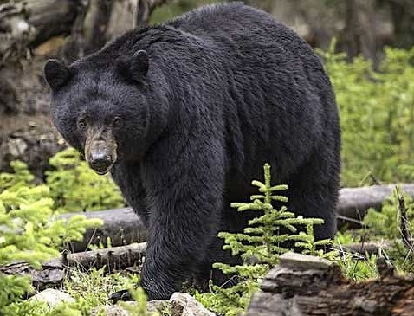
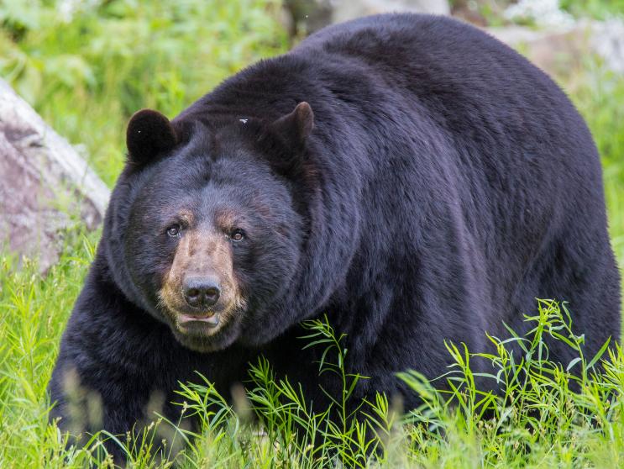
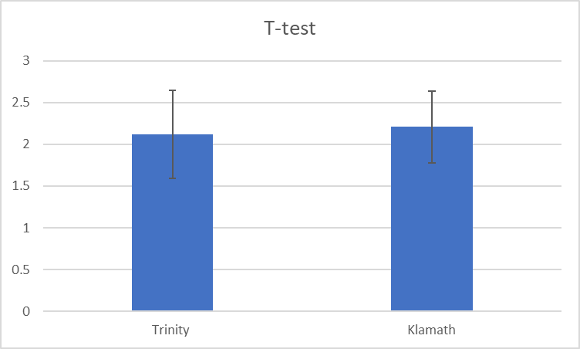
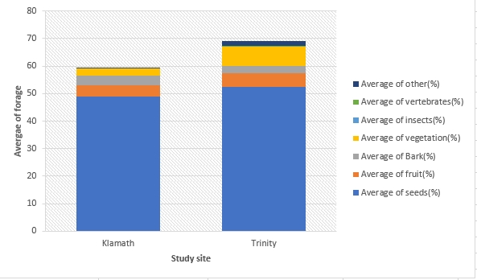
California Black Bear diet composition in the Trinity
and Klamath regions
Ethan R. Worthley
Department of Wildlife , Cal Poly Humboldt
INTRODUCTION
Northern California is home to a healthy and increasing population of California Black bears. Somewhere around 25,000-30,000 bears occupy 52,000sq. There are considered to be three sub-populations in the state (T. Katsnelson 2019). We are focusing on the North coast/cascade population. Both the Trinity and Klamath river are home to a large population of these Black bears that thrive in these regions because of the abundance of natural resources and available forage. Understanding the bear’s diet in each region can help us understand what these bear primarily feed on and what resources are available to them.
I collected bear scat from each region to determine what population of bears had a more diverse diet based on the Trinity and Klamath river regions.
Bear diet diversity
RESULTS
Based on diet composition, I found no difference between Trinity and Klamath bears diet diversity.(Pseudo –F= 1.58, df=1, 46, p=0.18). When dissecting each sample the diversity of what was found resulted in no significant difference between each region and what the bears foraged on (Figure 1).
After going through the 49 samples collected (25 Trinity) and (24 Klamath) it seems that most of the diet is composed of seeds and fruit with small variations between other dies items found in each sample (Figure 2).
Figure 1: T-Test to determine the difference of diet composition between the Trinity and the Klamath
DISCUSSION
The California Black bear (Ursus americanus californiensis) is found in many areas throughout California, especially in the Northern region such As Humboldt, Trinity, and Del Norte counties. These regions are home to an abundance of food that Black bears have access to year-round compared to many other places around the U.S. The Klamath and Trinity river systems have geographical differences and these bear populations use their resources in these areas all year round. Even with these differences the bears still rely heavily on the same forage regardless of differences in the region.
METHODS
I collected 49 samples 25 from the Trinity river and 24 from the Klamath River. This was achieved by finding areas where bears often used to travel. After collecting each sample I then bagged and separated the samples by location. I then went through each sample using dissecting tools recording any identifiable forage to determine the content, species richness, and percentage of how much content was in that single sample.
Figure 2: The amount of forage(%) that was found In the bear scat between the Klamath and Trinity regions
Work cited: Katsnelson , T. 2020. How are California bears doing? The Aggie Transcript. &lt;https://aggietranscript.ucdavis.edu/how-are-california-bears-doing/&gt; Accessed 25 Apr 2022.

