Slide 1
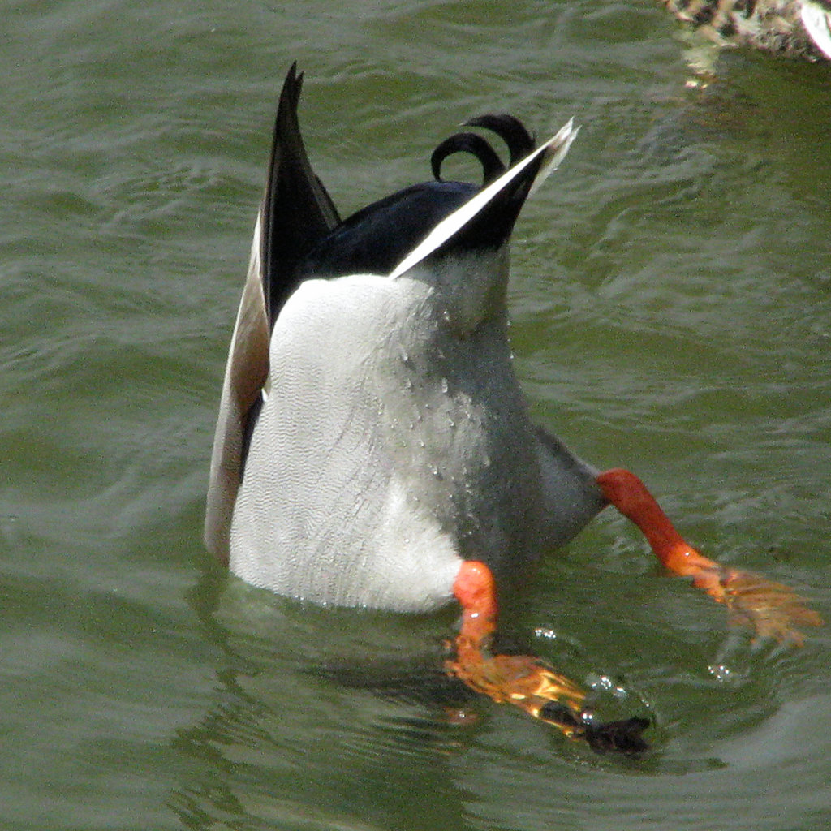
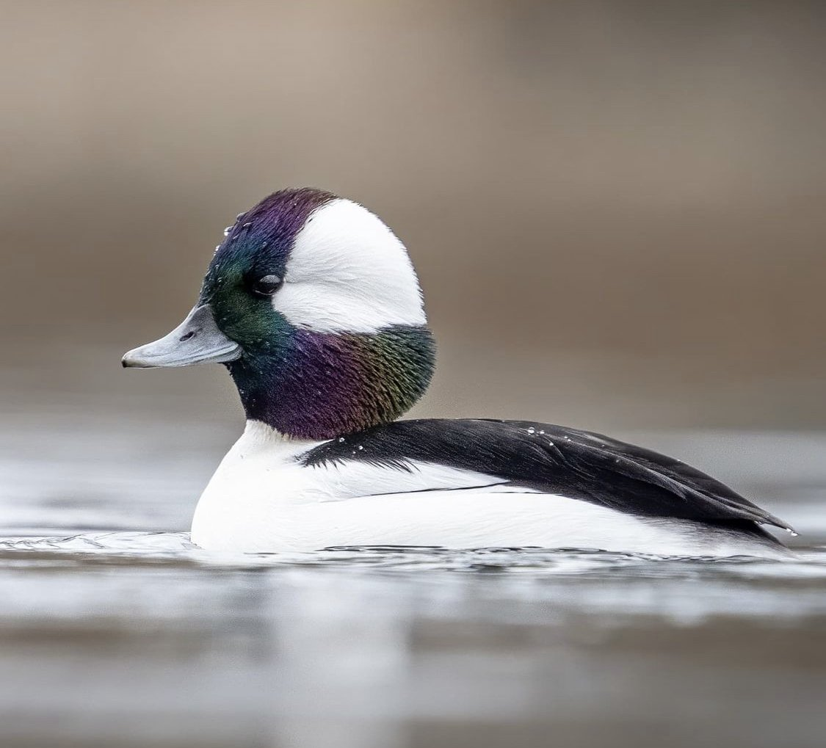
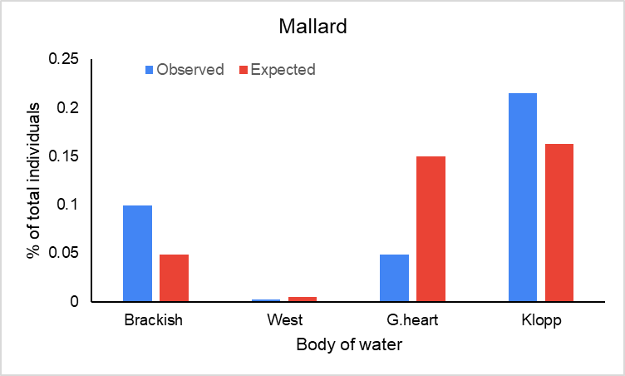
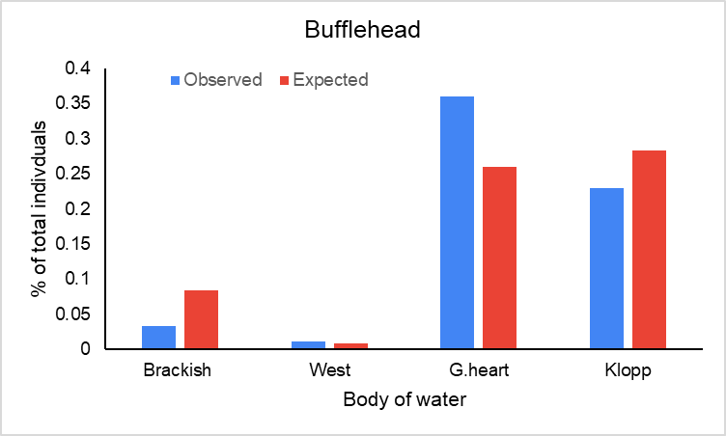
Salinity influence in feeding of dabbling and diving ducks
Cesar J. Rocha
Department of Wildlife, Cal Poly Humboldt
INTRODUCTION
Salinity in water has shown to give added benefits to waterfowl such as improve reproductive success, increase growth for ducklings, and affects prebasic molts among other things (Richardson and Kaminski 1992; Hornung and Foote 2008; Schacter et al. 2021).
Comparing Buffleheads (Bucephala albeola) and Mallards (Anas platyrhynchos), I used these bodies of water: Gearheart (0.4ppt); West (17.5ppt); Brackish (33.9ppt); and Klopp (34.4ppt) to see which they prefer.
I predicted that there would be more feeding activities in bodies of water with higher salinity.
RESULTS
Duck abundances varied among ponds (X²= 183.1, df=3, P<0.001). Mallards were most present at Klopp compared to Brackish (Fig 1.). Buffleheads were most present at Gearheart compared to Klopp (Fig. 2). Mallards exhibited disproportionately more feeding behavior than expected by chance at Brackish (16%), and no foraging at Klopp. Buffleheads foraged at Gearheart (19%) and Klopp (42%) in proportion to their expected values.
DISCUSSION
Both species exhibited most feeding at waters with highest salinity.
Mallards showed disproportionate feeding at Klopp than expected, exhibiting most feeding behavior at Brackish. Using site based off its availability.
Buffleheads exhibited proportionate feeding at expected site, despite being most present at Gearheart.
Supporting that waterfowl prefer waters with higher salinity, possibly for the benefits that it offers (Richardson and Kaminski 1992; Hornung and Foote 2008; Schacter et al. 2021).
Figure 1.
METHODS
Collected total number of individuals using point counts. Going to four points at each pond. Then randomly choose individual, using random number generator, within flock to observe for 5.5 min. and record its behavior every 15 sec (Johnson and Rowher 2000). Behaviors recorded were foraging and non-foraging. Bufflehead foraging was recorded as diving/diving pause and surface. Mallard was dabbling and head dip.
Chi-squared test was used to analyze the abundance and feeding at each pond.
Figure 2.
LITERATURE CITED
Honung, J.P., and A.L. Foote. 2008. Comparing dietary preferences of Bufflehead ducklings in Western Canada through gut content
and stable isotope analysis. Aquatic Ecology 42:61-70.
Johnson, W.P., and F.C. Rohwer. 2000. Foraging Behavior of Green-winged teal and Mallards on tidal flats in Louisiana. Society of
Wetlands Scientist 20:184-188.
Richardson, D.M., and R.M. Kaminski. 1992. Diet restriction, diet quality, and prebasic molt in female Mallards. The Journal of Wildlife
Management 3:531-539.
Schacter, C.R., S.H. Peterson, M.P. Herzog, C.A. Hartman, M.L. Casazza, and J.T. Ackerman. 2021. Wetland availability and salinity
concentrations for breeding waterfowl in Suisun Marsh, California. San Francisco Estuary and Watershed Science 19:1-25.
ACKNOWLEDGMENTS
Dr. Sean Mahoney, Advisor

