Slide 1
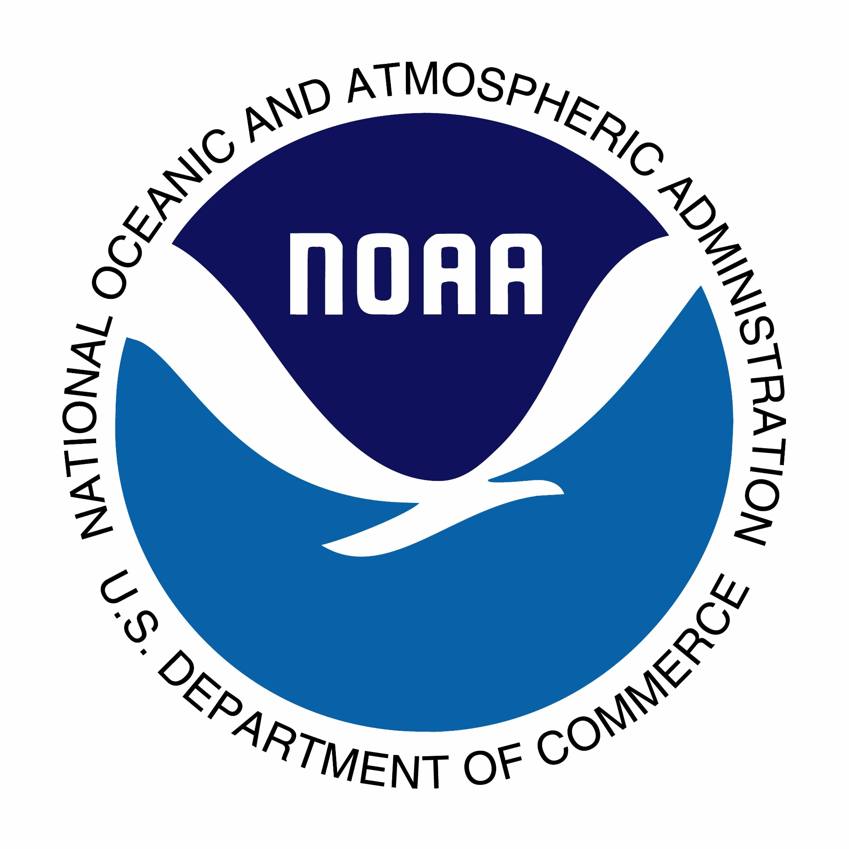
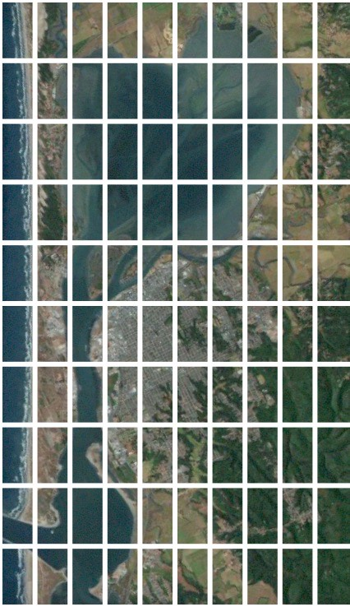
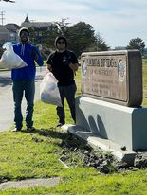
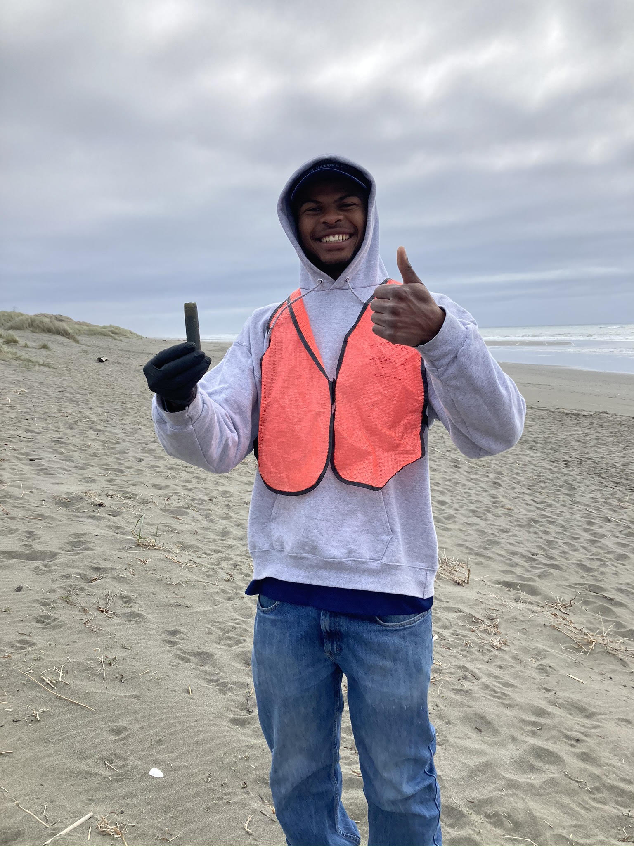
Investigating shotgun shell and wad waste around Humboldt Bay
Daniel Montoya, Noah Jenkins, Madison Richardson, Sarah Moreau, Jose R. Marin Jarrin,
Cal Poly Humboldt
Abstract
Shotguns often used for hunting, when fired, they produce a plastic wad and shell
In order to estimate abundance of shotgun wads and shells, eight randomly selected sites in Humboldt Bay were sampled once during March 2022
Sites sampled included the beach and bay side of the Samoa Peninsula, Arcata, and Eureka
At selected sites, 400 m² were inspected for wads, shells and trash
Only one shotgun wad and shell was collected at two different sites (0.25 wads and shells per 100 m², average of 0.26 kg of trash per 100 m²
Our results suggest that during this time of year, there are little plastic wads, shells and garbage on the shorelines of Humboldt Bay
6
Methods
Four students sampled 8 randomly sites around Humboldt Bay to determine presence and abundance of shotgun shells and plastic wads
Sample sites: Humboldt Bay’s shoreline, including the beach and bay side of the Samoa Peninsula, Arcata, Eureka, and Southern Humboldt Bay
2 100-m transect lines were surveyed, two people walked along each transect line, one on each side searching for waste
The person on the left side of transect line searched from transect line out to 1 m to left of line, and person on right searched from transect line out to 1 m to right of line, for a total of 200 m²
41
42
45
54
66
Transect Line
2 meters
100 meters
Results
7 sites sampled
1 site unsampled (red)
1 Shotgun wad collected
1 Shotgun shell collected
Abundance of 0.25 wads
and shells per 100 m²
7.285 kg of trash collected
total at all sites
Abundance of 0.26 kg of
trash per 100 m²
Introduction
Humboldt Bay has extensive shoreline home to many animals ranging from fish to birds
Shotgun shell and wad are made of plastic, often left behind in natural environment, potentially ending in waterways when hunting for ducks near ponds
Prior to 1970 shotgun wads were made of cardboard
Humboldt county representatives are hoping to make the switch back to cardboard and the data collected by this project may assist with that
The project aimed to quantify the locations of shotgun wads and shells
Sampling Site # | Shotgun Wad | Shotgun Shell | Trash weight (kg) | Date
45 | 0 | 0 | 1.984 | 2/25/22
83
66 | 0 | 0 | 0 | 3/7/22
99 | 0 | 0 | 0 | 3/7/22
54 | 0 | 0 | 0.255 | 3/7/22
6 | 0 | 0 | 1.077 | 3/15/22
41 | 0 | 1 | 0.567 | 3/29/22
42 | 1 | 0 | 3.402 | 3/29/22
83
99
Discussion
It was challenging to find shells and wads randomly
There are people who collect large numbers of both in Humboldt county
They use surfrider shotgun wad watcher to ensure they find the waste
Our results suggest that during this time of year, there are little plastic wads, shells and garbage on the shorelines of Humboldt Bay.

