Slide 1
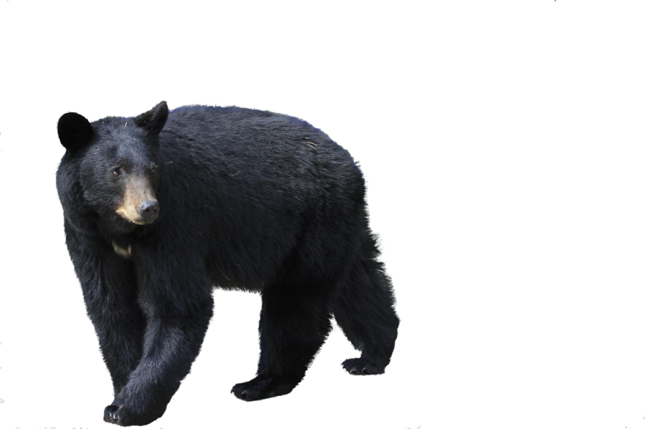
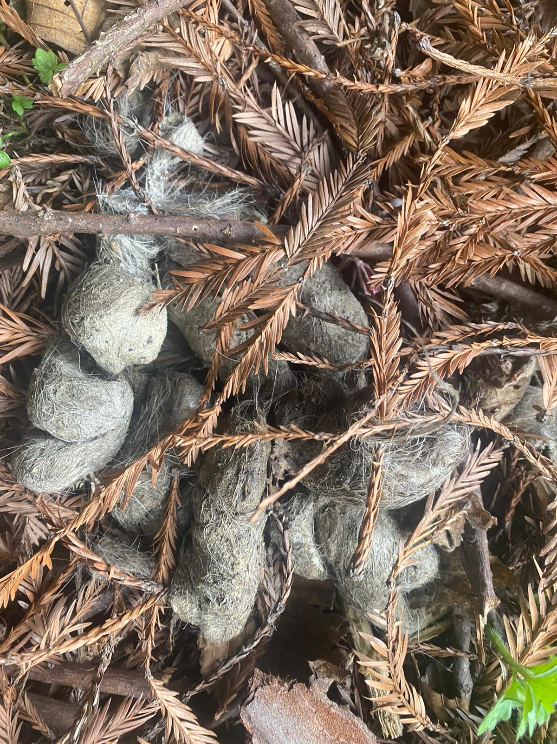
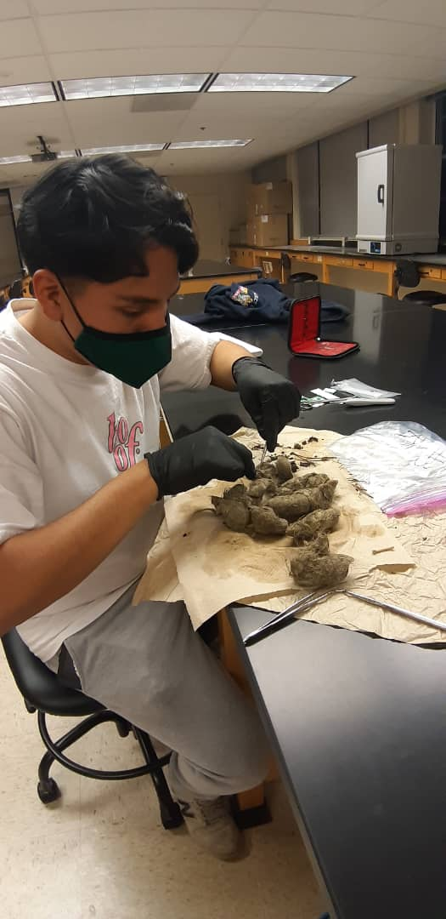
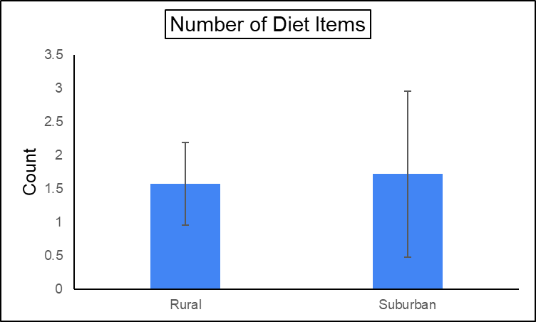
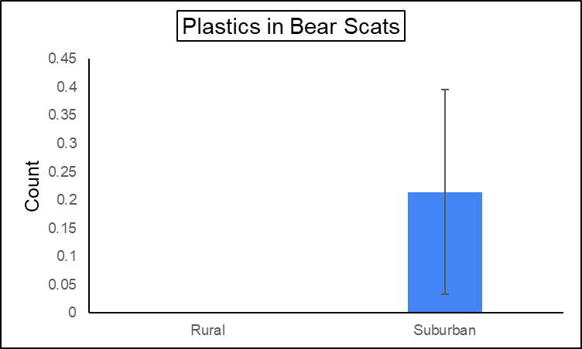
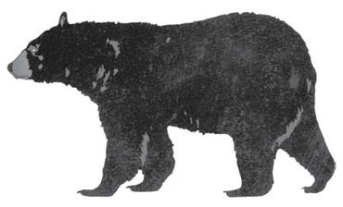
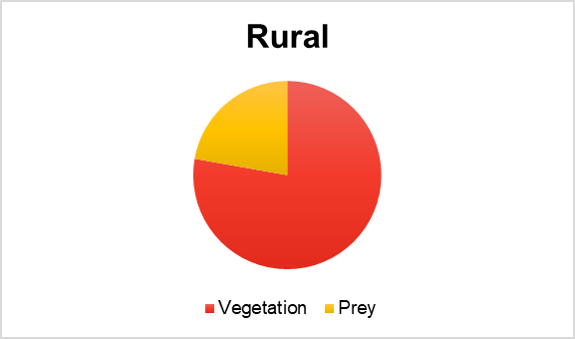
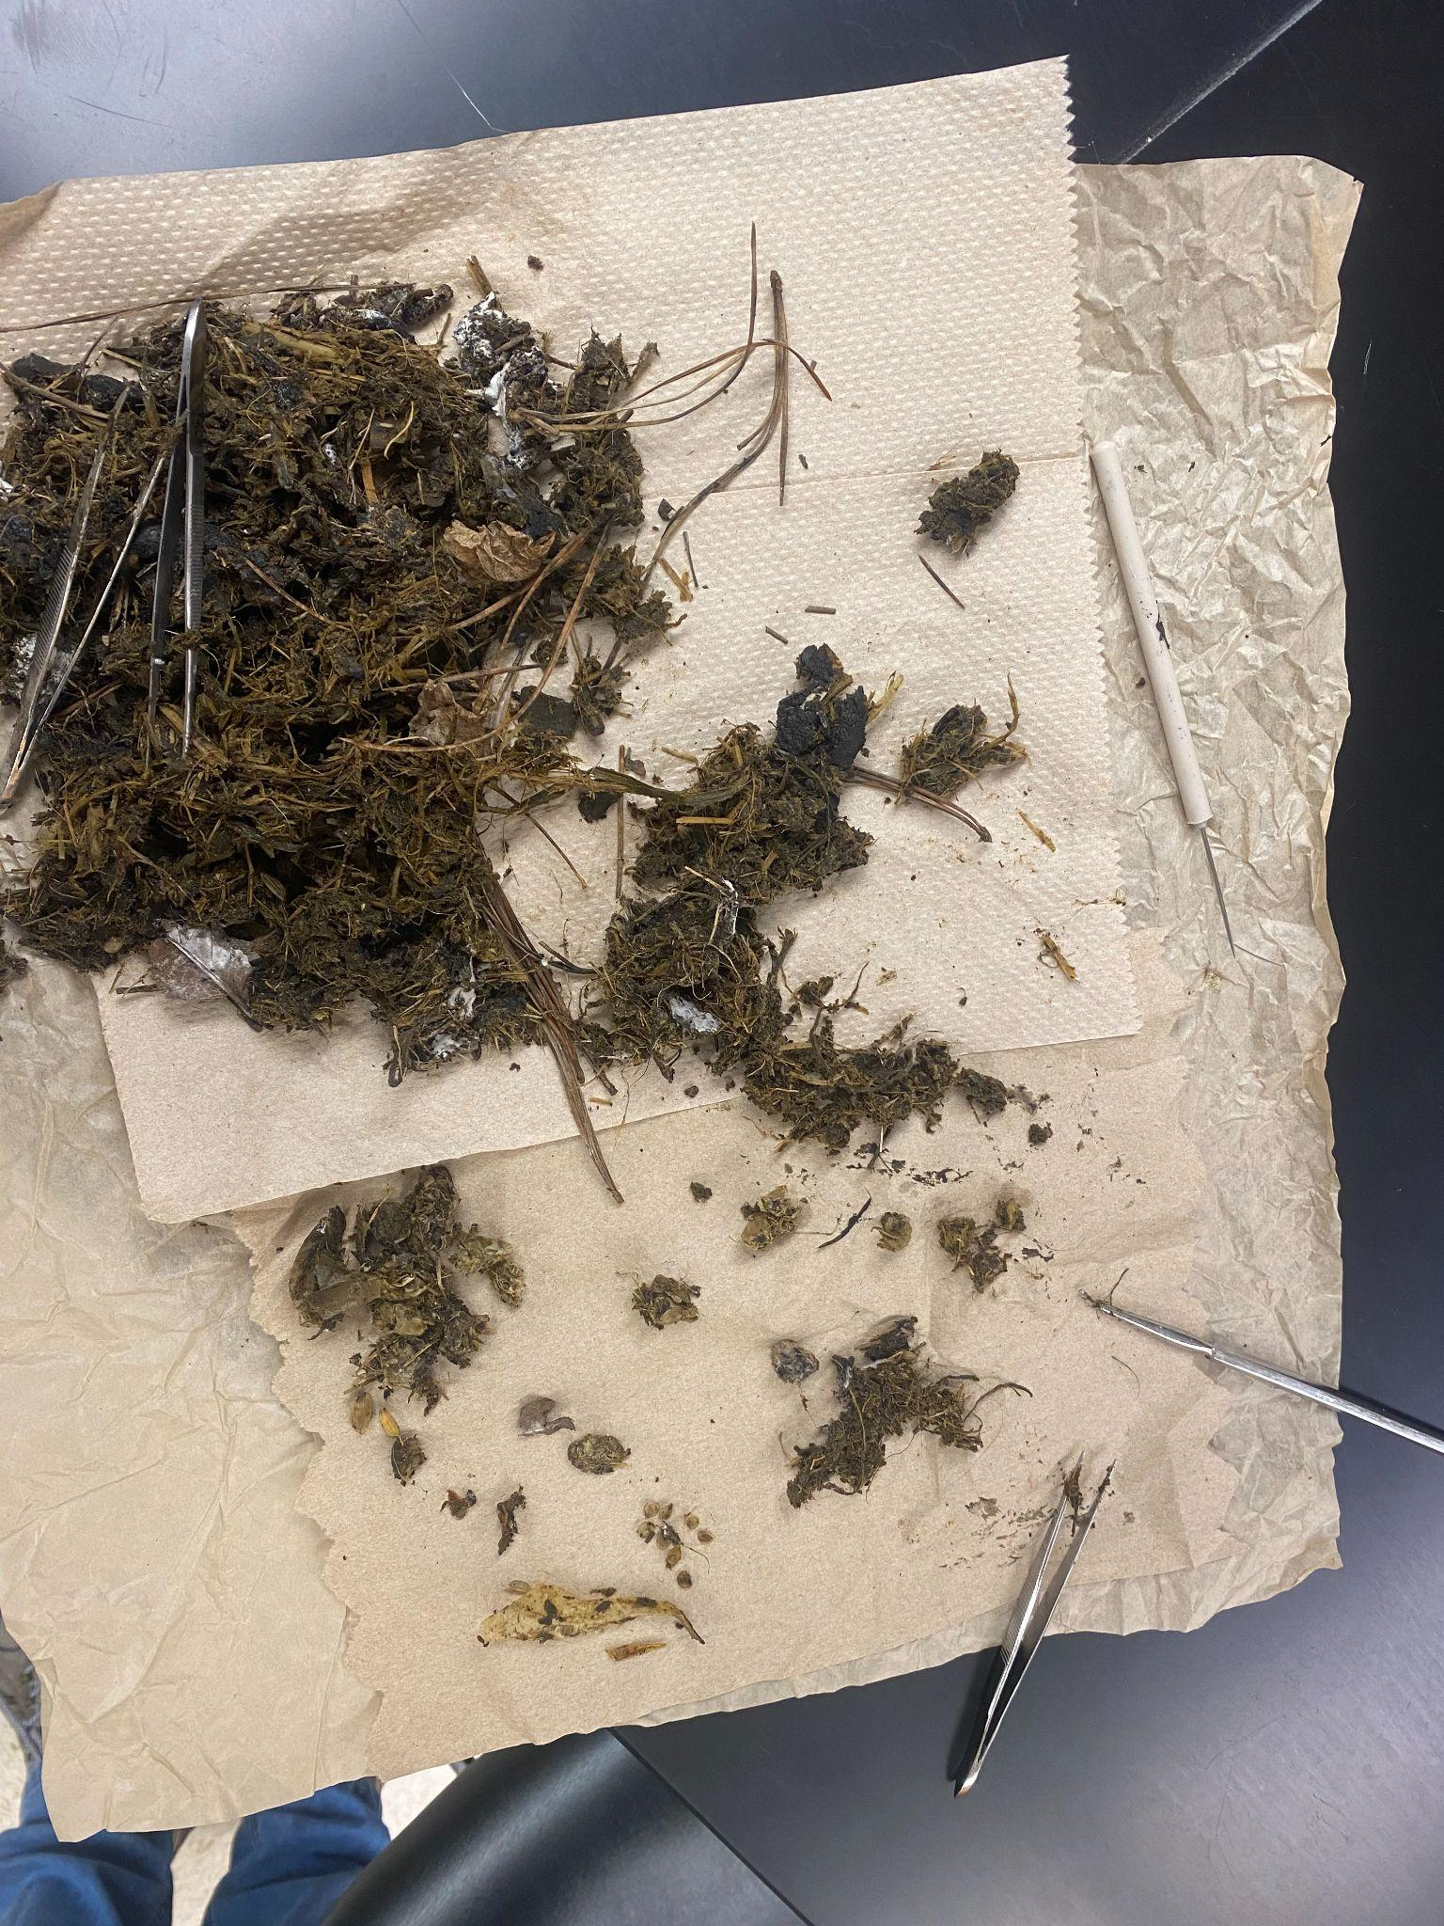
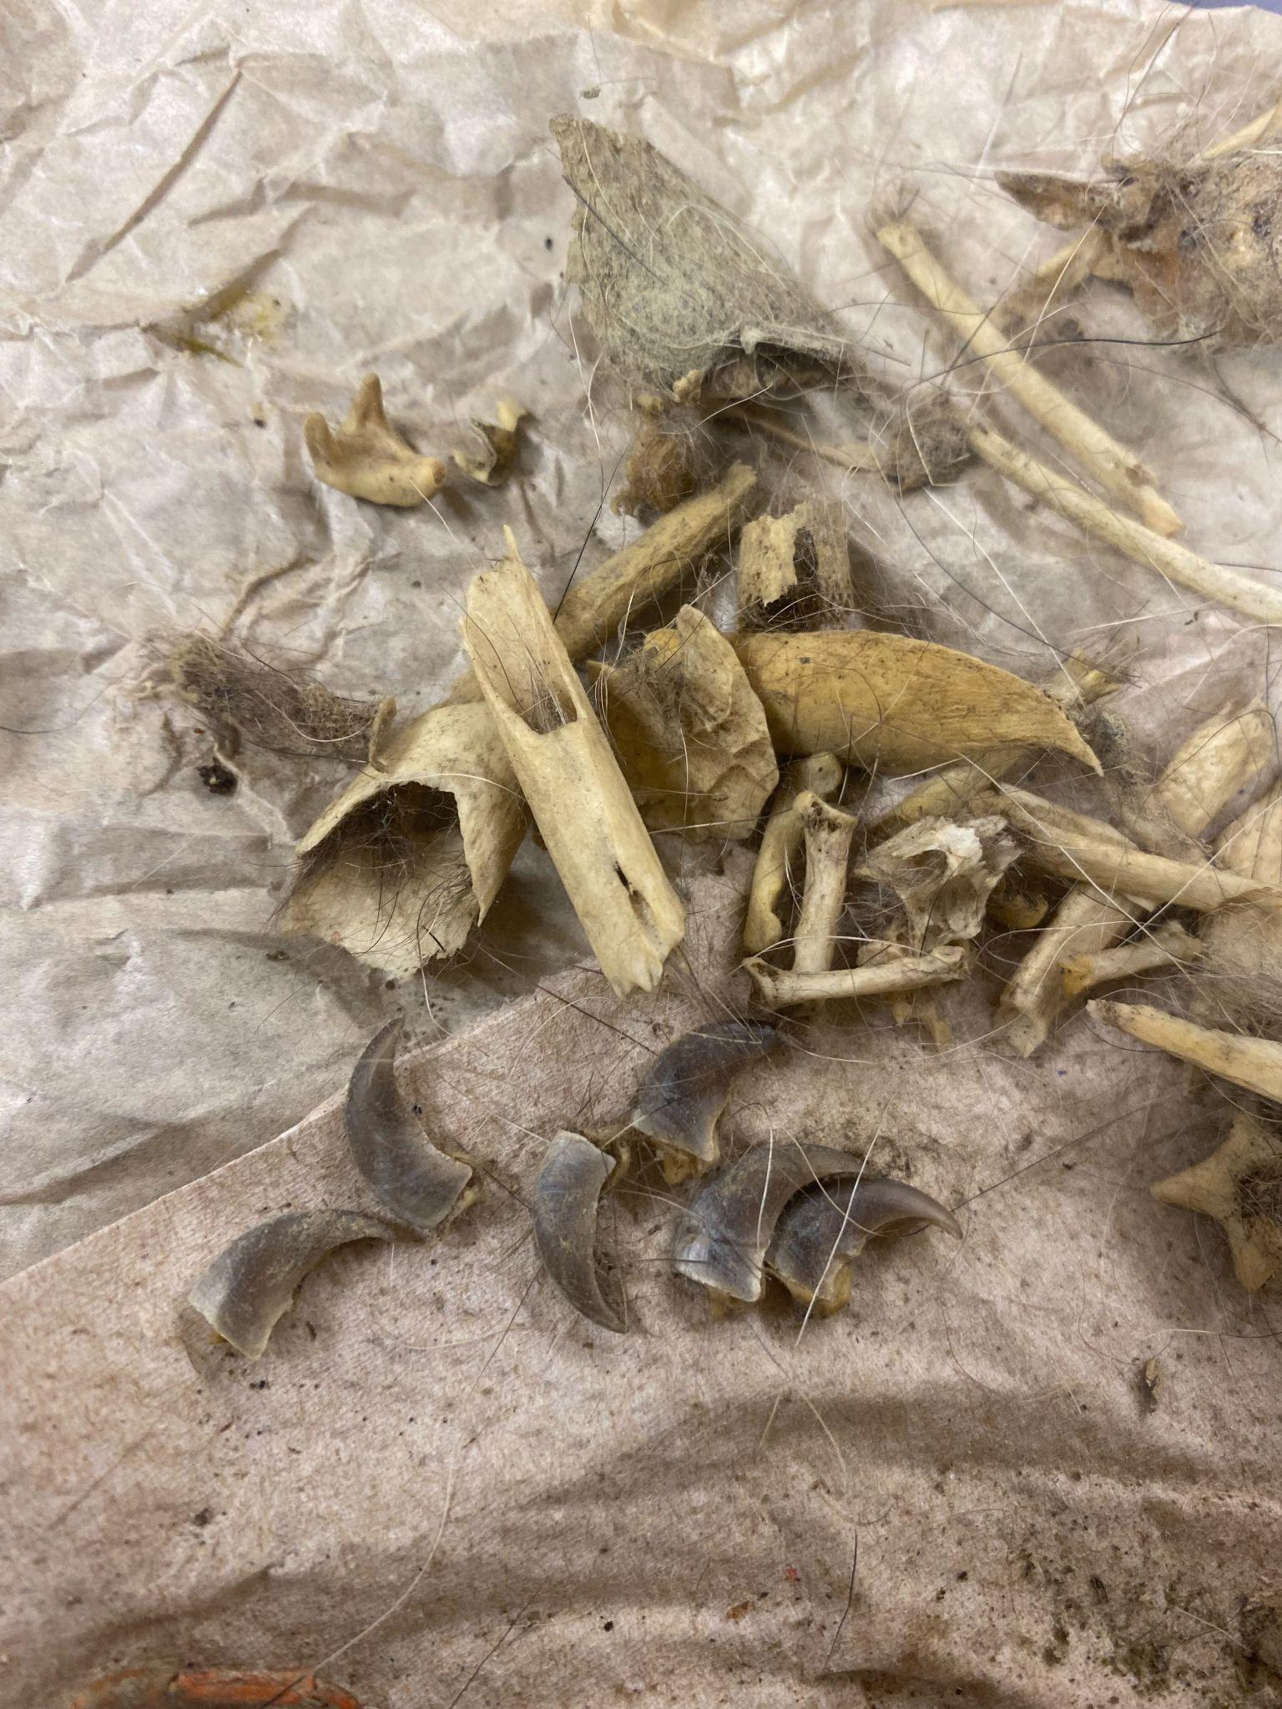
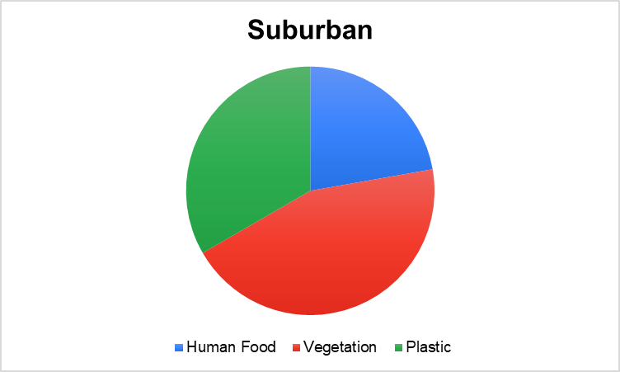
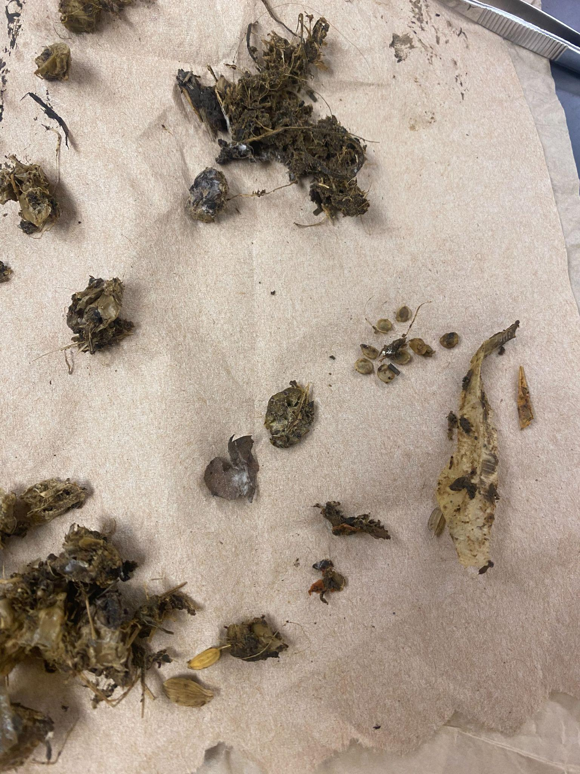
Black bears in suburban areas consume more anthropogenic foods
Alexander Arroyo
Department of Wildlife at Cal Poly Humboldt
INTRODUCTION
Consumption of human food by black bears (Ursus americanus) is a common and challenging problem for wildlife managers dealing with the species; as omnivores, bears will readily use human-associated foods as an easily attainable energy source, especially when natural food sources are scarce (David M. Graber et al. 1983). The result of human expansion is increased rates of encounters between humans and bears, particularly if bears are being forced to search farther and wider outside their home ranges for food. In this study I assessed variation in anthropogenic foods in bear diets. To accomplish this, I compared scat samples collected in Humboldt, CA from suburban and rural areas. I predicted scats from suburban areas would contain more anthropogenic food than bear scats from rural areas.
RESULTS
I found bear diet breadth did not differ between the rural and suburban areas (Figure 1, t=-0.08, df=11, p=0.79). However, scats from suburban areas contained more plastics on average, than the rural scats (Figure 2, t=-1.89, df=13, p=0.04). No anthropogenic food was found in the rural scats (Figure 3). The majority of the food items sampled and detected from the rural areas were plant and prey items (Figure 3). When sorting through each sample, the analysis of the samples indicated that bears in suburban areas consumed human food/plastic items (Figure 4). The plastics were likely plastic straws and small pieces of microplastics (Figure 4).
Figure 1. Mean number of diet items in collected scats from rural/suburban areas
Figure 2. Mean number of plastic items in collected scats from rural/suburban areas
DISCUSSION
Human foods were foods originally intended for human consumption but were observed more often in black bear scats from suburban areas. Bears may turn to anthropogenic food sources in order to satisfy their daily caloric needs, which may potentially increase human-bear conflicts. Although additional research is needed, my evidence suggests bears are exploiting anthropogenic food resources in suburban areas in Humboldt County. To reduce the risk of human-bear conflicts, an important first step that can be done is for people in suburban areas to use bear proof trash cans. Black bears have good vision, very good hearing, and an extremely keen sense of smell, but a bear proof trash can make it difficult for them to access anthropogenic food. This will subsequently reduce human-bear conflicts.
Vegetation
METHODS
I collected a total of 14 scats in Humboldt, CA between February and April 2022. 7 scats were collected from Arcata, CA (suburban) and the 7 scats in the rural areas were collected from Orick,CA and Big Lagoon, CA (rural). I dissected all samples individually using forceps. After dissecting and collecting the categorized items in the scats, each individual scat was placed in a circled wired mesh filter and warm water running through the scats to help look for any other items that were not found during the dissecting process with forceps. All items found in the scats were categorized as plastics, fruit, nuts/seeds, prey, and vegetation. Each item was classified as either present or absent in a sample. I then tested for differences in diet breadth (i.e. number of different diet items) and number of anthropogenic food items (evidence of plastic and citrus fruit) using two separate t-tests.
Prey
Figure 3. Scat analysis in rural areas. Vegetation and prey were the items found.
Straw
Plastics
Acknowledgements
I would like to thank the Department of Wildlife at Cal Poly Humboldt for providing the materials for this project. I appreciate my professor Sean M. Mahoney for the support and to my fellow classmates in WLDF 495 for the helpful comments and corrections for this project. Additionally, I wanna thank Danial Nayeri for the help during the dissecting process. Barbara Larrondo and Cesar Aguilar for helping me find the collected scats.
Figure 4. Scat analysis in suburban areas. Plastics and human food were the most detected items.
Human food: Citrus Fruit
Literature Cited
Graber, D. M., and M. White. 1983. Black Bear Food Habits in Yosemite National Park. Bears: Their Biology and Management 5:1.
Beeman, L. E., and M. R. Pelton. 1980. Seasonal Foods and Feeding Ecology of Black Bears in the Smoky Mountains. Bears: Their Biology and Management 4:141.
Notes:
ADD:
Move pie charts left more and bigger. Plus the pics bigger
Add figure captions
For bear in middle, add a neighborhood pic and forest pic
Make my pic of dissecting bigger
Erase human food and plastics of pie chart in rural areas
Fix results

