Slide 1
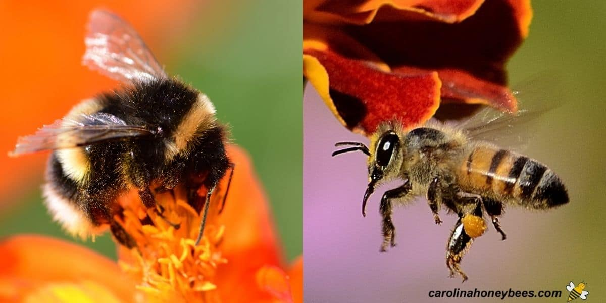
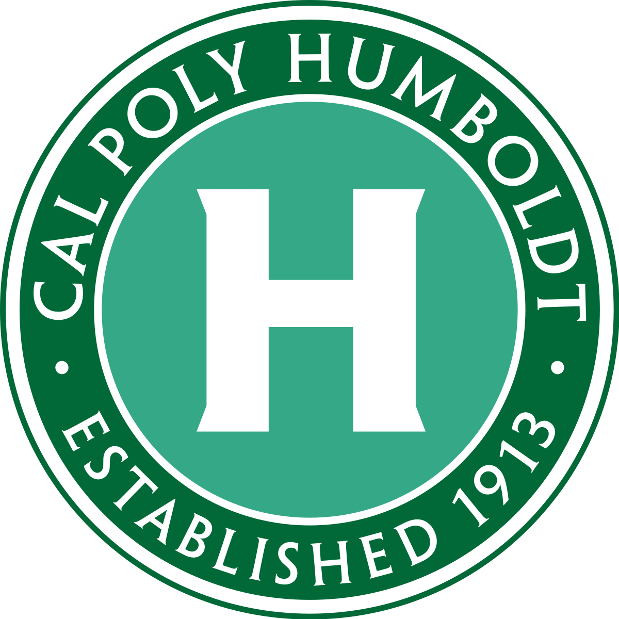
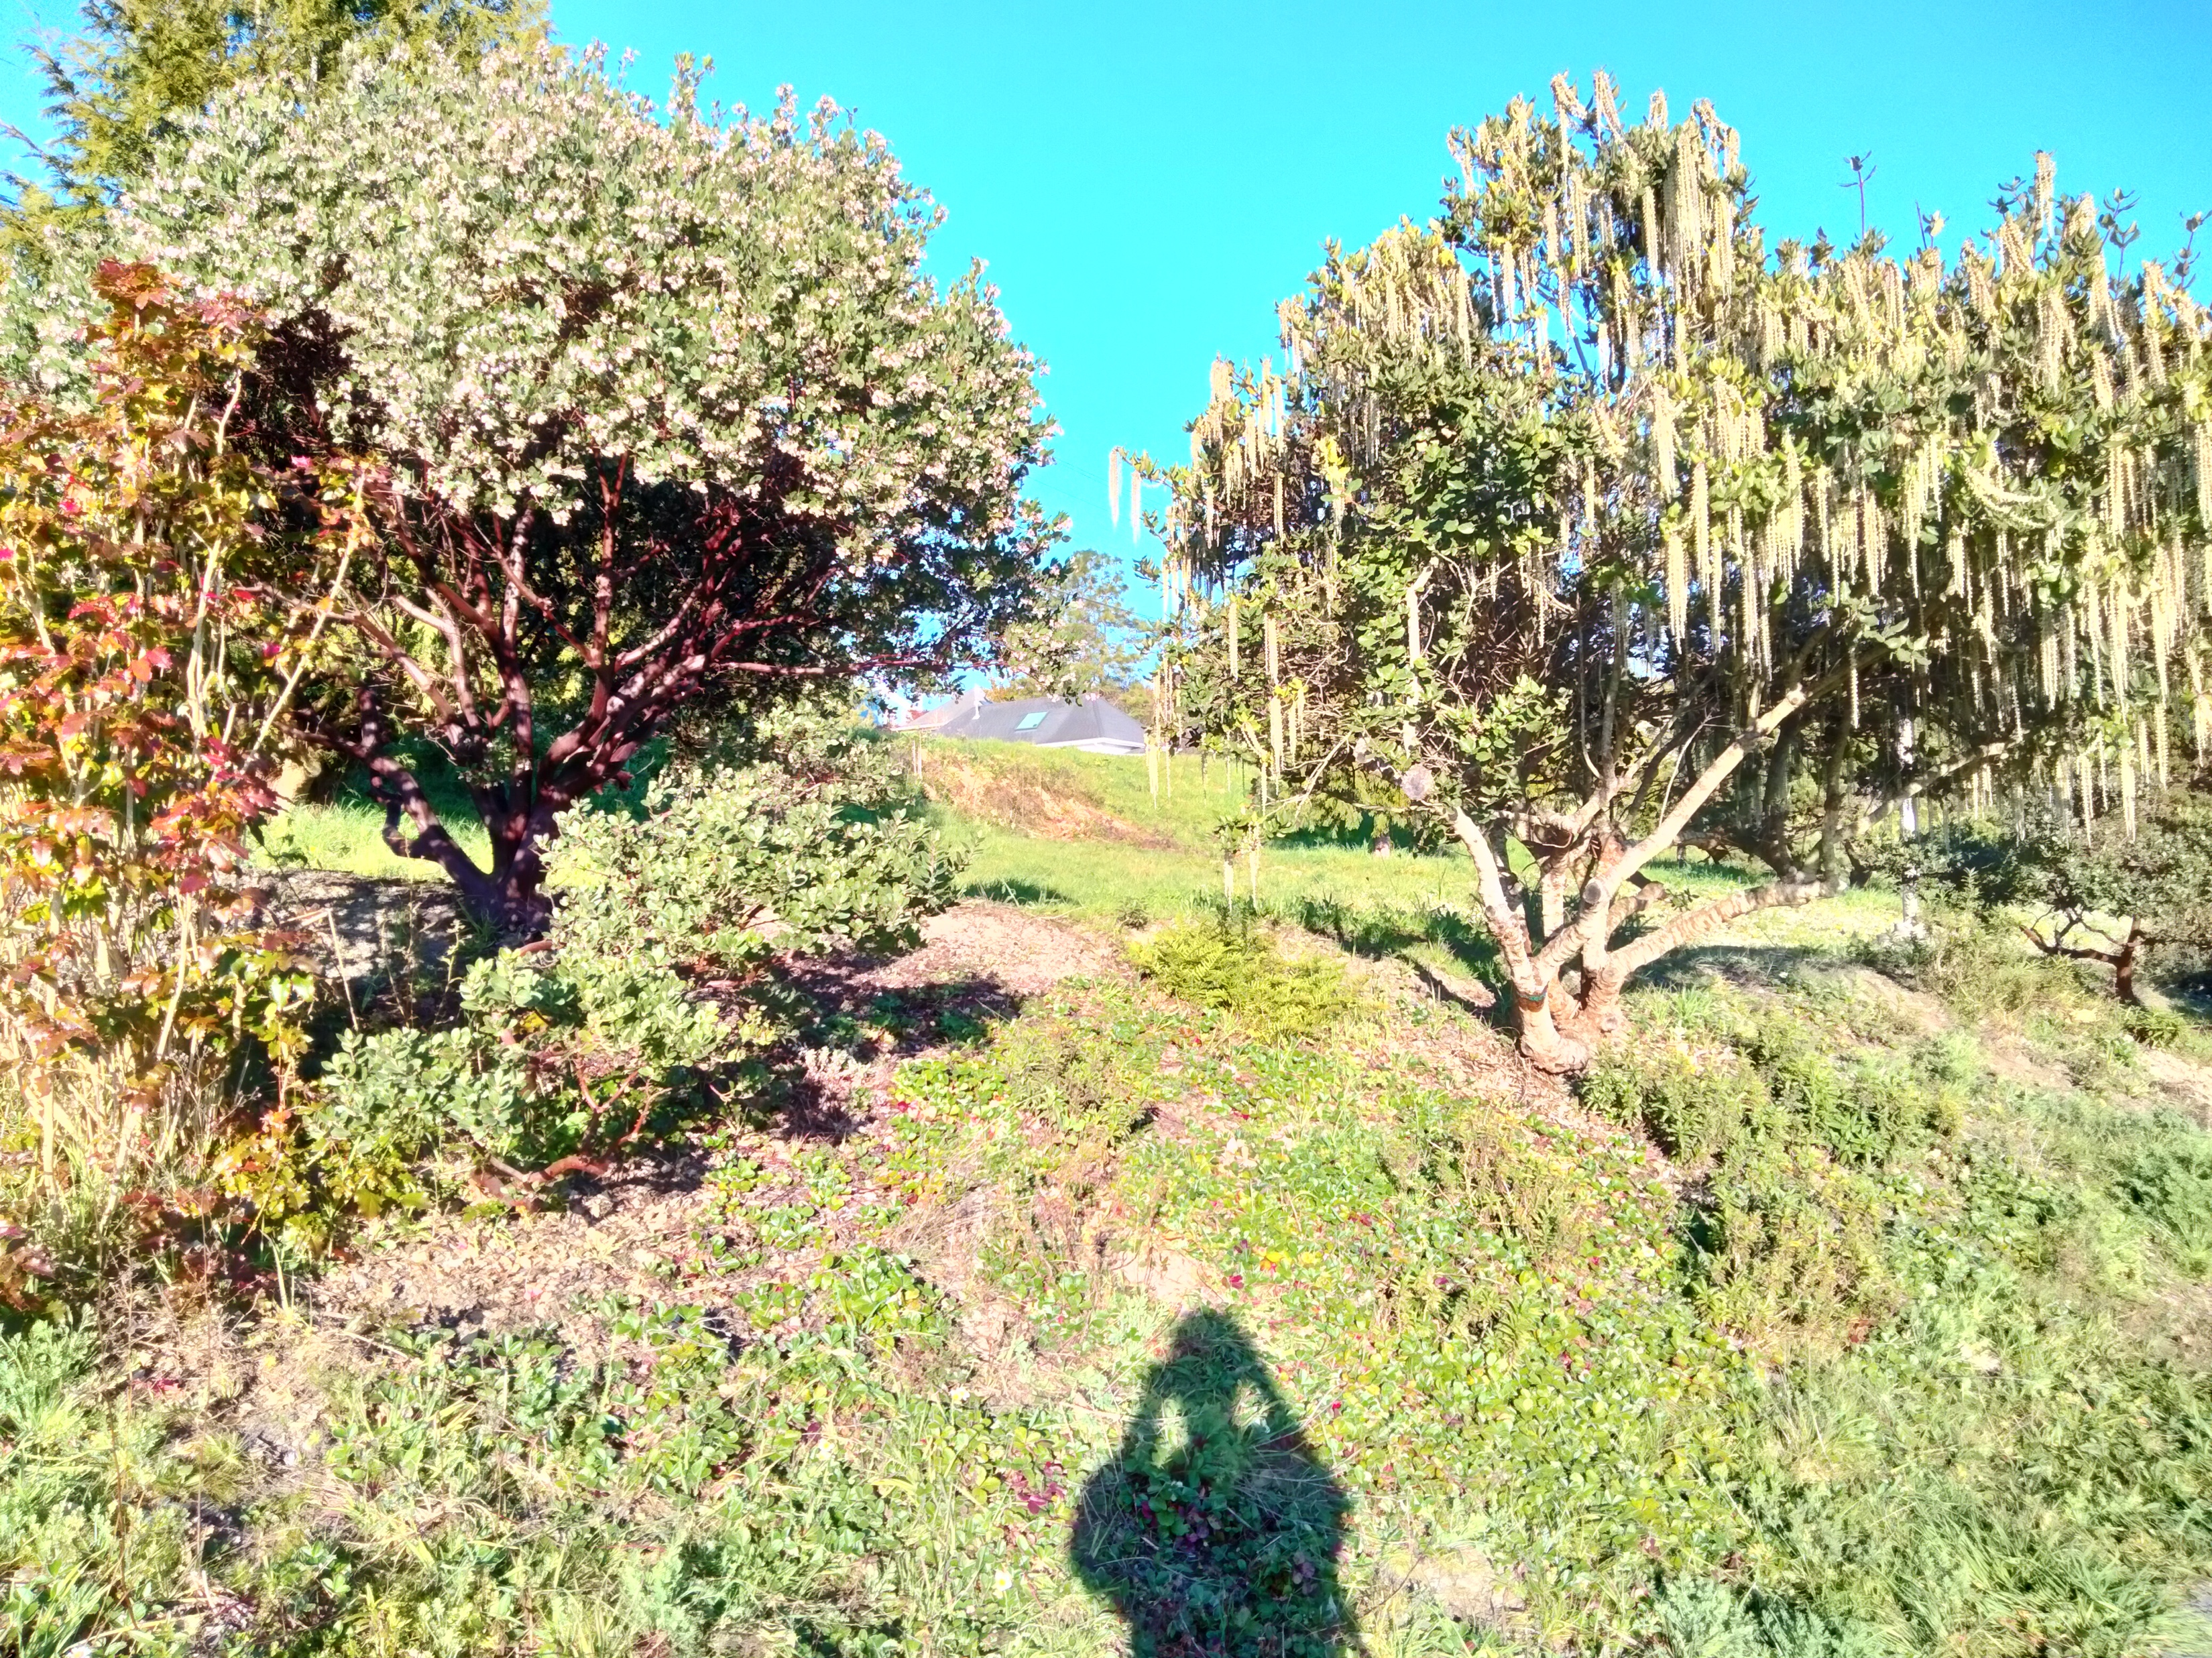
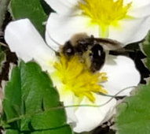
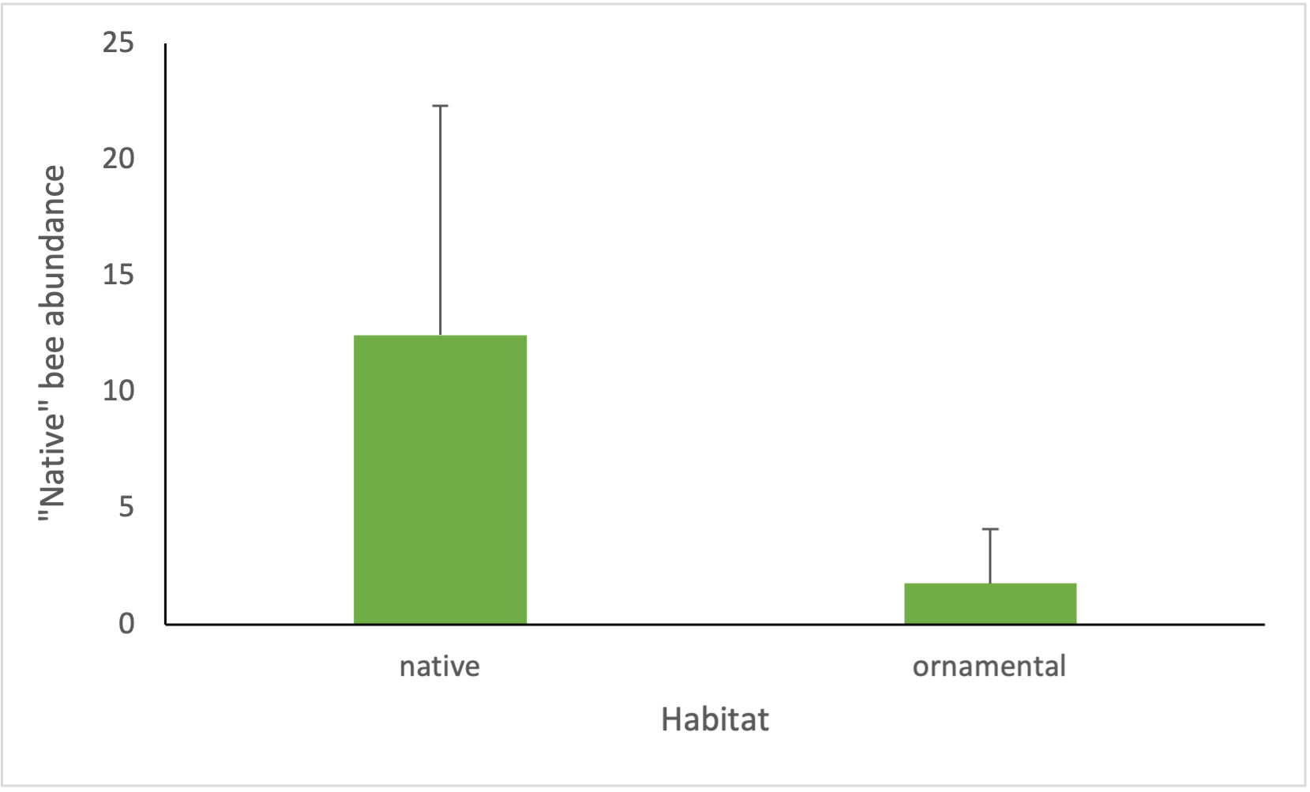
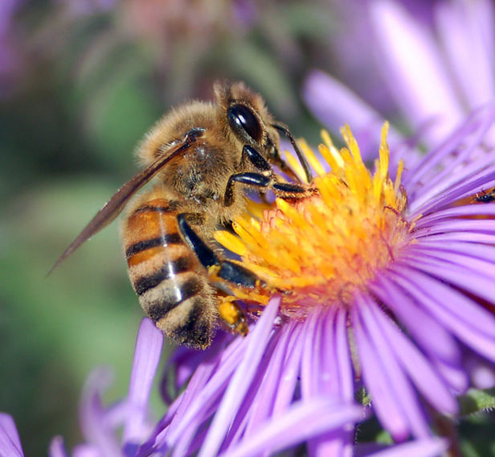
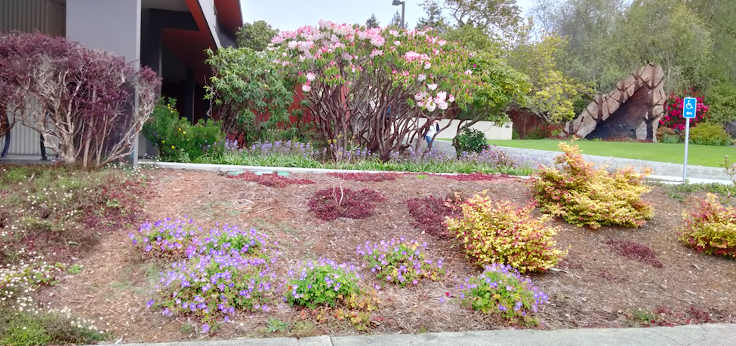
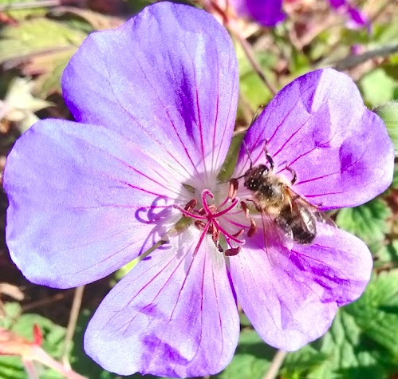
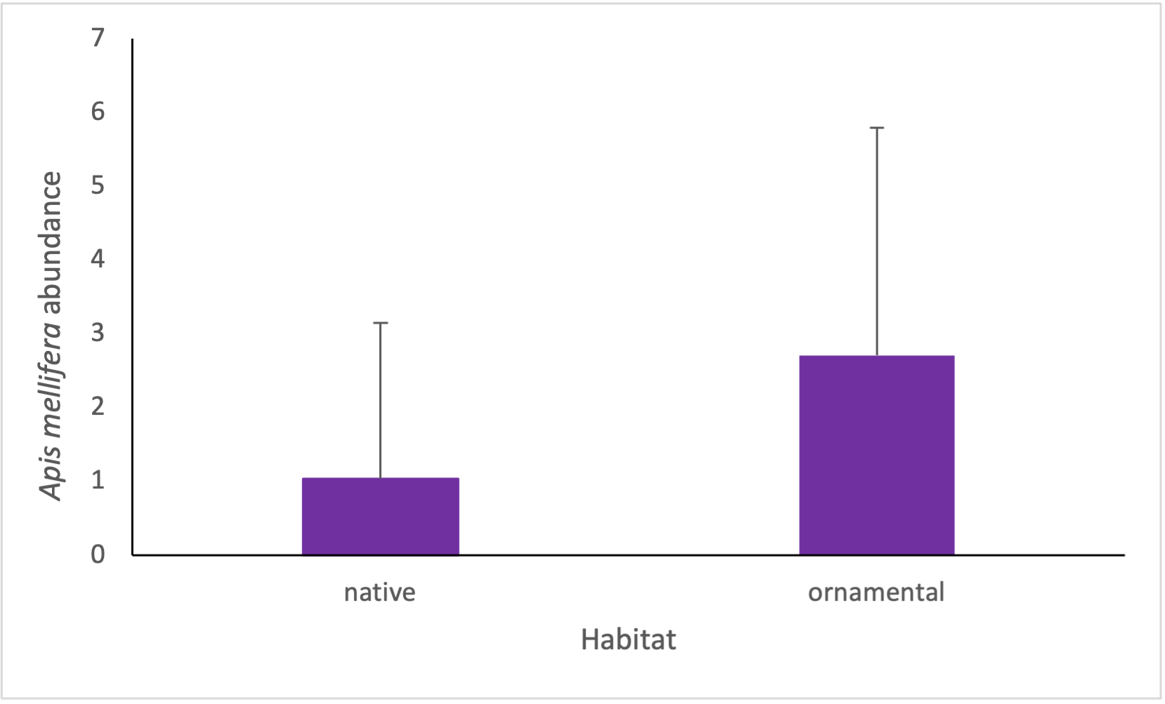
Bee abundance and composition in native vs non-native urban gardens
Adrienne Menduno-Ortbals
Department of Wildlife, Cali Poly Humboldt
INTRODUCTION
As climate change progresses, emergence time of bees may be affected. It has been found that phenological mismatches occur in bee species and flowering plants due to climate change (Stemkovski et al. 2020). This may be especially true for native bees with less behavioral plasticity. The domesticated European honey bee (Apis mellifera) may be more plastic in behavior due to having a wide geographical range in association with humans. Additionally, non-native Apis mellifera may be better suited to take advantage of urban, non-native gardens than native bee species due to this historical anthropogenic support. While there is support that native plants are beneficial to native bees (Morandin and Kremen 2012), in California native bees have also been found in association with non-native plants as well (Frankie et al. 2019). Thus, more studies comparing native bee abundance in gardens with mostly non-native plants and all native plants will only add to our understanding of how to better support native bees in urban areas. For my study I asked:
Will Apis mellifera prefer non-native urban gardens more than native bee species?
Conversely, will native bee species be more abundant in native plant gardens?
Will there be a difference in the abundance of bees over the time of the study period?
RESULTS
Based on ANOVA tests, I found a significantly higher abundance of non-Apis mellifera in native garden habitats (Fig. 1, F_{1,106}=36.8, p<0.000), and a significantly higher abundance of Apis mellifera in ornamental gardens (Fig. 2, F_{1,106}=10.4, p=0.002). Flower abundance was higher in ornamental gardens (F_{1,50}=8.085, p=0.006).
Using a PERMANOVA, I found a significant difference in bee community composition between gardens (Pseudo-F_{1,101}=28.05, p=0.001).
In both Apis mellifera (R²=0.144, p=0.0001), and native bees (R²=0.126, p=0.0002), there was an increase in abundance over the course of the study period.
F_{1,106}=36.8, p<0.000|
DISCUSSION
I found more native bees in native gardens and more Apis mellifera in mostly non-native gardens. Aside from having plant preferences, it may be that Apis mellifera outcompete native bees in urban areas in which their resources overlap (Prendergast et al. 2021). Despite urban resources, honey bee abundance was not constant in gardens over time as I predicted. Apis mellifera and native bees including mostly Bombus both increased in abundance over time, supporting the natural increase in pollinators as temperatures increase from winter into spring.
To make successful comparisons of bee communities over time it would be better to sample for the whole season in which bees are active. In Southwest Australia it was found that there were positive and negative correlations between native and honeybee richness in different years (Prendergast et al. 2021), showing the importance of studies over multiple years. This is especially important when making comparisons in emergence timing to understand how climate change is affecting different bees.
Figure 1: Higher non-Apis bee abundance was found in native gardens
METHODS
I counted bees at two native, and mostly non-native gardens with visual observations within an area of 10 by 6 meters, standing on a line transect at points 3 and 8 meters along the 10-meter side for 10 minutes each. Bees were tallied into the category's European honey bee, Bombus, and Other. Date and time was recorded to see if there were any changes in abundance over the course of the study. Flowers were counted after the point counts of bees within a 1 by 1-meter square sampling frame with a clicker counter in the same four areas within each site.
I used RStudio to analyze the data with ANOVA and PERMANOVA tests. I used Excel to make figures and analyze abundance over time via linear regressions.
F_{1,106}=10.4, p=0.002|
LITERATURE CITED
Prendergast, K. S., K. W. Dixon, and P. W. Bateman. 2021. Interactions between the introduced European Honey Bee and native bees in urban areas varies by year, habitat type and native bee guild. Biological Journal of the Linnean Society 133:725–743.
Slominski, A. H., and L. A. Burkle. 2021. Asynchrony between solitary bee emergence and flower availability reduces flower visitation rate and may affect offspring size. Basic and Applied Ecology 56:345–357.
Frankie, G., I. Feng, R. Thorp, J. Pawelek, M. H. Chase, C. C. Jadallah, and M. Rizzardi. 2019. Native and non-native plants attract diverse bees to urban gardens in California. Journal of Pollination Ecology 25.
Morandin, L. A., and C. Kremen. 2012. Bee preference for native versus exotic plants in restored agricultural hedgerows. Restoration Ecology 21:26–32.
FUNDING SOURCES N/A ACKNOWLEDGMENTS
Cal Poly Humboldt Department of Wildlife stockroom for materials, and Sean M. Mahoney and advice throughout the study. Thank you to my friends Gabrielle Gangitano and Gabby White for helping me brainstorm study ideas.
Figure 2: Higher Apis mellifera abundance found in mostly non-native gardens

