Slide 1
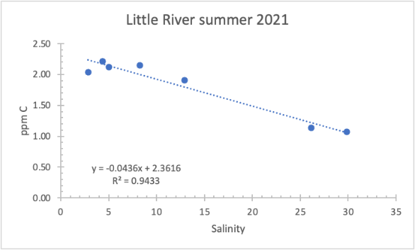
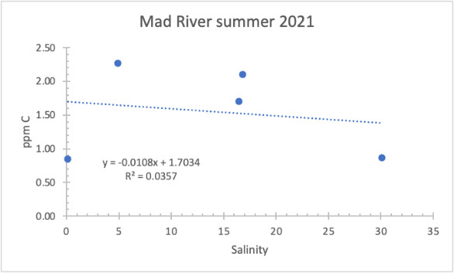
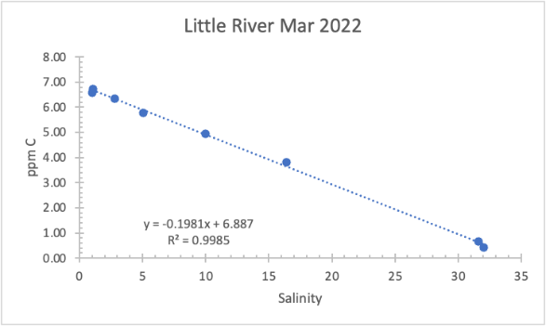
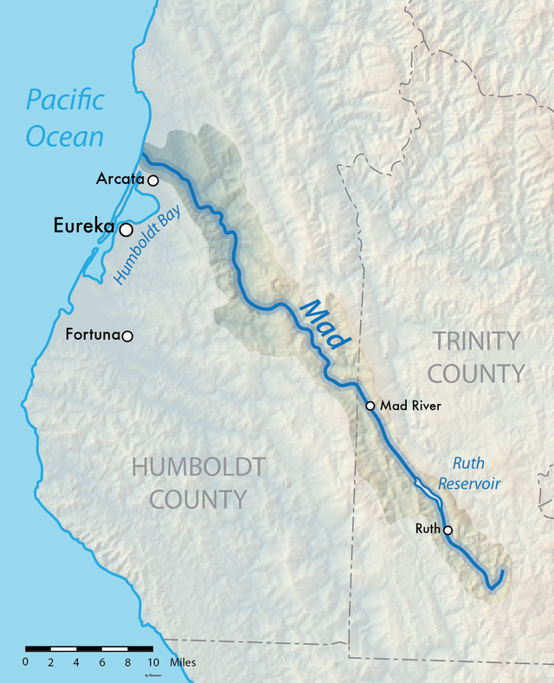
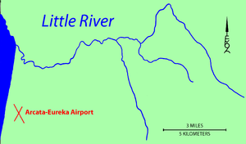
DOC Sampling in Little River and Mad River
Mark Moreno, David Zeitz, Claire Till
Chemistry Department, California State Polytechnic University, Humboldt
sdfkjlkajd
Introduction
Dissolved Organic Carbon (DOC) a fraction of organic carbon the size less than 0.2 micrometers. DOC comes from decomposed plants, bacteria, and algae. Abundant in marine and freshwater systems, it serves as the primary food source for aquatic webs. Generally, rivers have higher concentrations of DOC than the ocean does.
With increasing salinity, DOC concentration decreases as it dissolves into salt water. The negative linearity is like Scandium dissolved in the ocean but greatly differs from iron.
Methods
Took samples from the estuaries of the Little River and Mad River (below) in August 2021, and one more test through Little River in March 2022. Salinity was measured with a YSI probe. DOC samples were acidified and frozen until analysis for preservation then run through a DOC Sampler to compare concentration to increasing salinity.
(FIGURES Below taken from Wikipedia)
Results
Discussion
All linear negative slopes. Concentrations decreased from river to ocean. Scholarly articles have pointed this to be normal as DOC is higher in colder waters. The dynamic is most present when comparing seasons. (FIGURE BELOW: Osterholz, Helena, et al. "Environmental drivers of dissolved organic matter molecular composition in the Delaware Estuary." Frontiers in Earth Science 4 (2016): 95.)
Scholarly articles such as the figure above indicate the dilution from fresh to salt water creates the normal relationship between DOC and salinity. Aug 2012-2013 data is indicative of some extra source of DOC not seen in personal data.
Summer and Winter in Little River evidently normal. See figure above with Nov. 2011- 2013 data: note change in concentration in both river and seawater.
Possible explanations for changes in concentration:
Colder water absorbs more DOC
Seasonal plant growth on land and in the ocean
More rainwater during the season transporting DOC
Next Steps
Interpretation of data will continue as we compare with data from metals and pursue the possible explanations above.
And of course: more sampling!
Little River – strong linear relationship!
Relationship is dynamic
Mad River - possibly linear – more data needed
Notes:
Draft a short description (700 characters or less). Send to me Sunday night.

