Slide 1
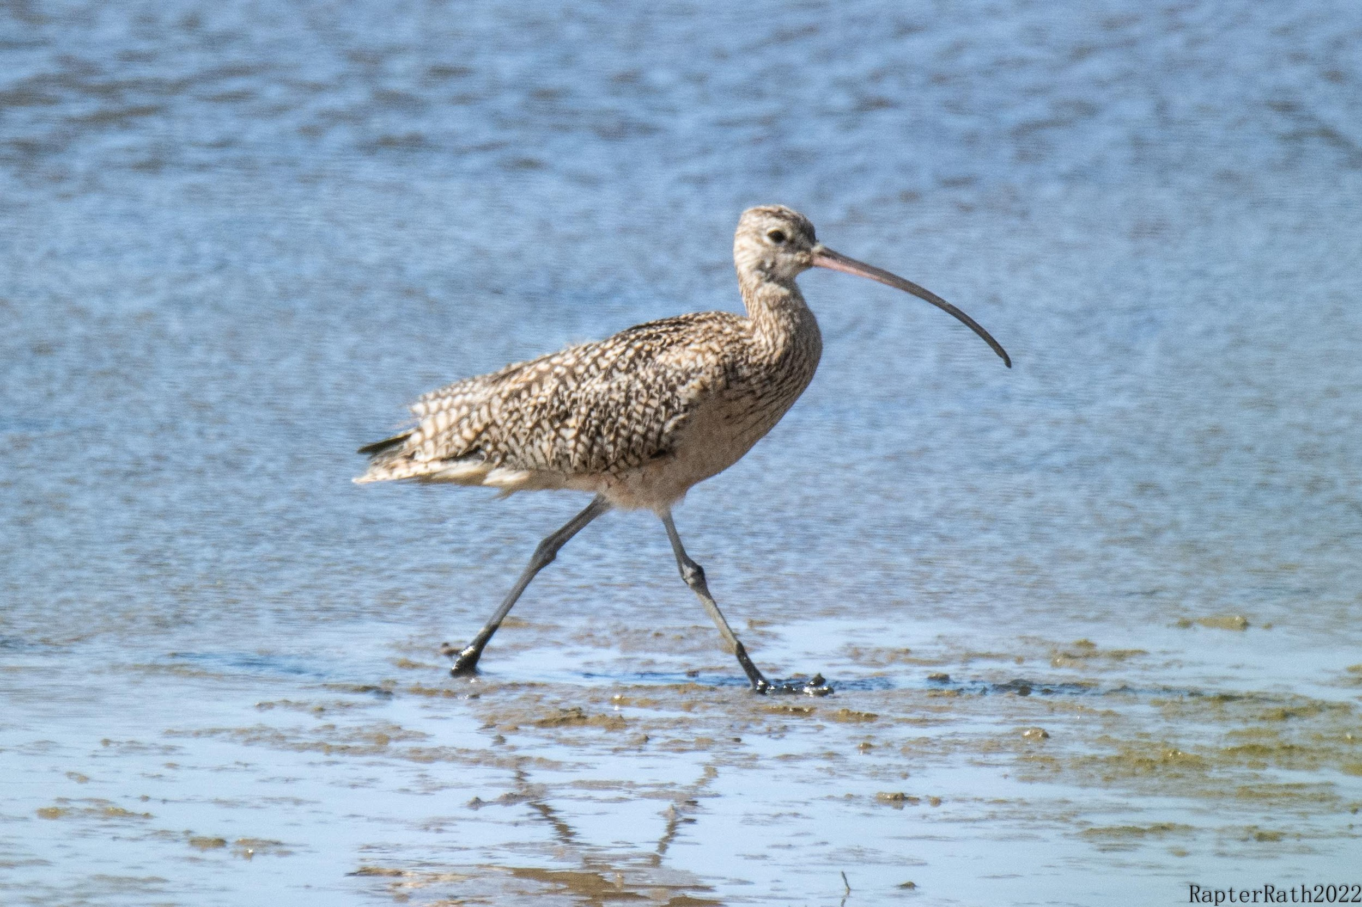
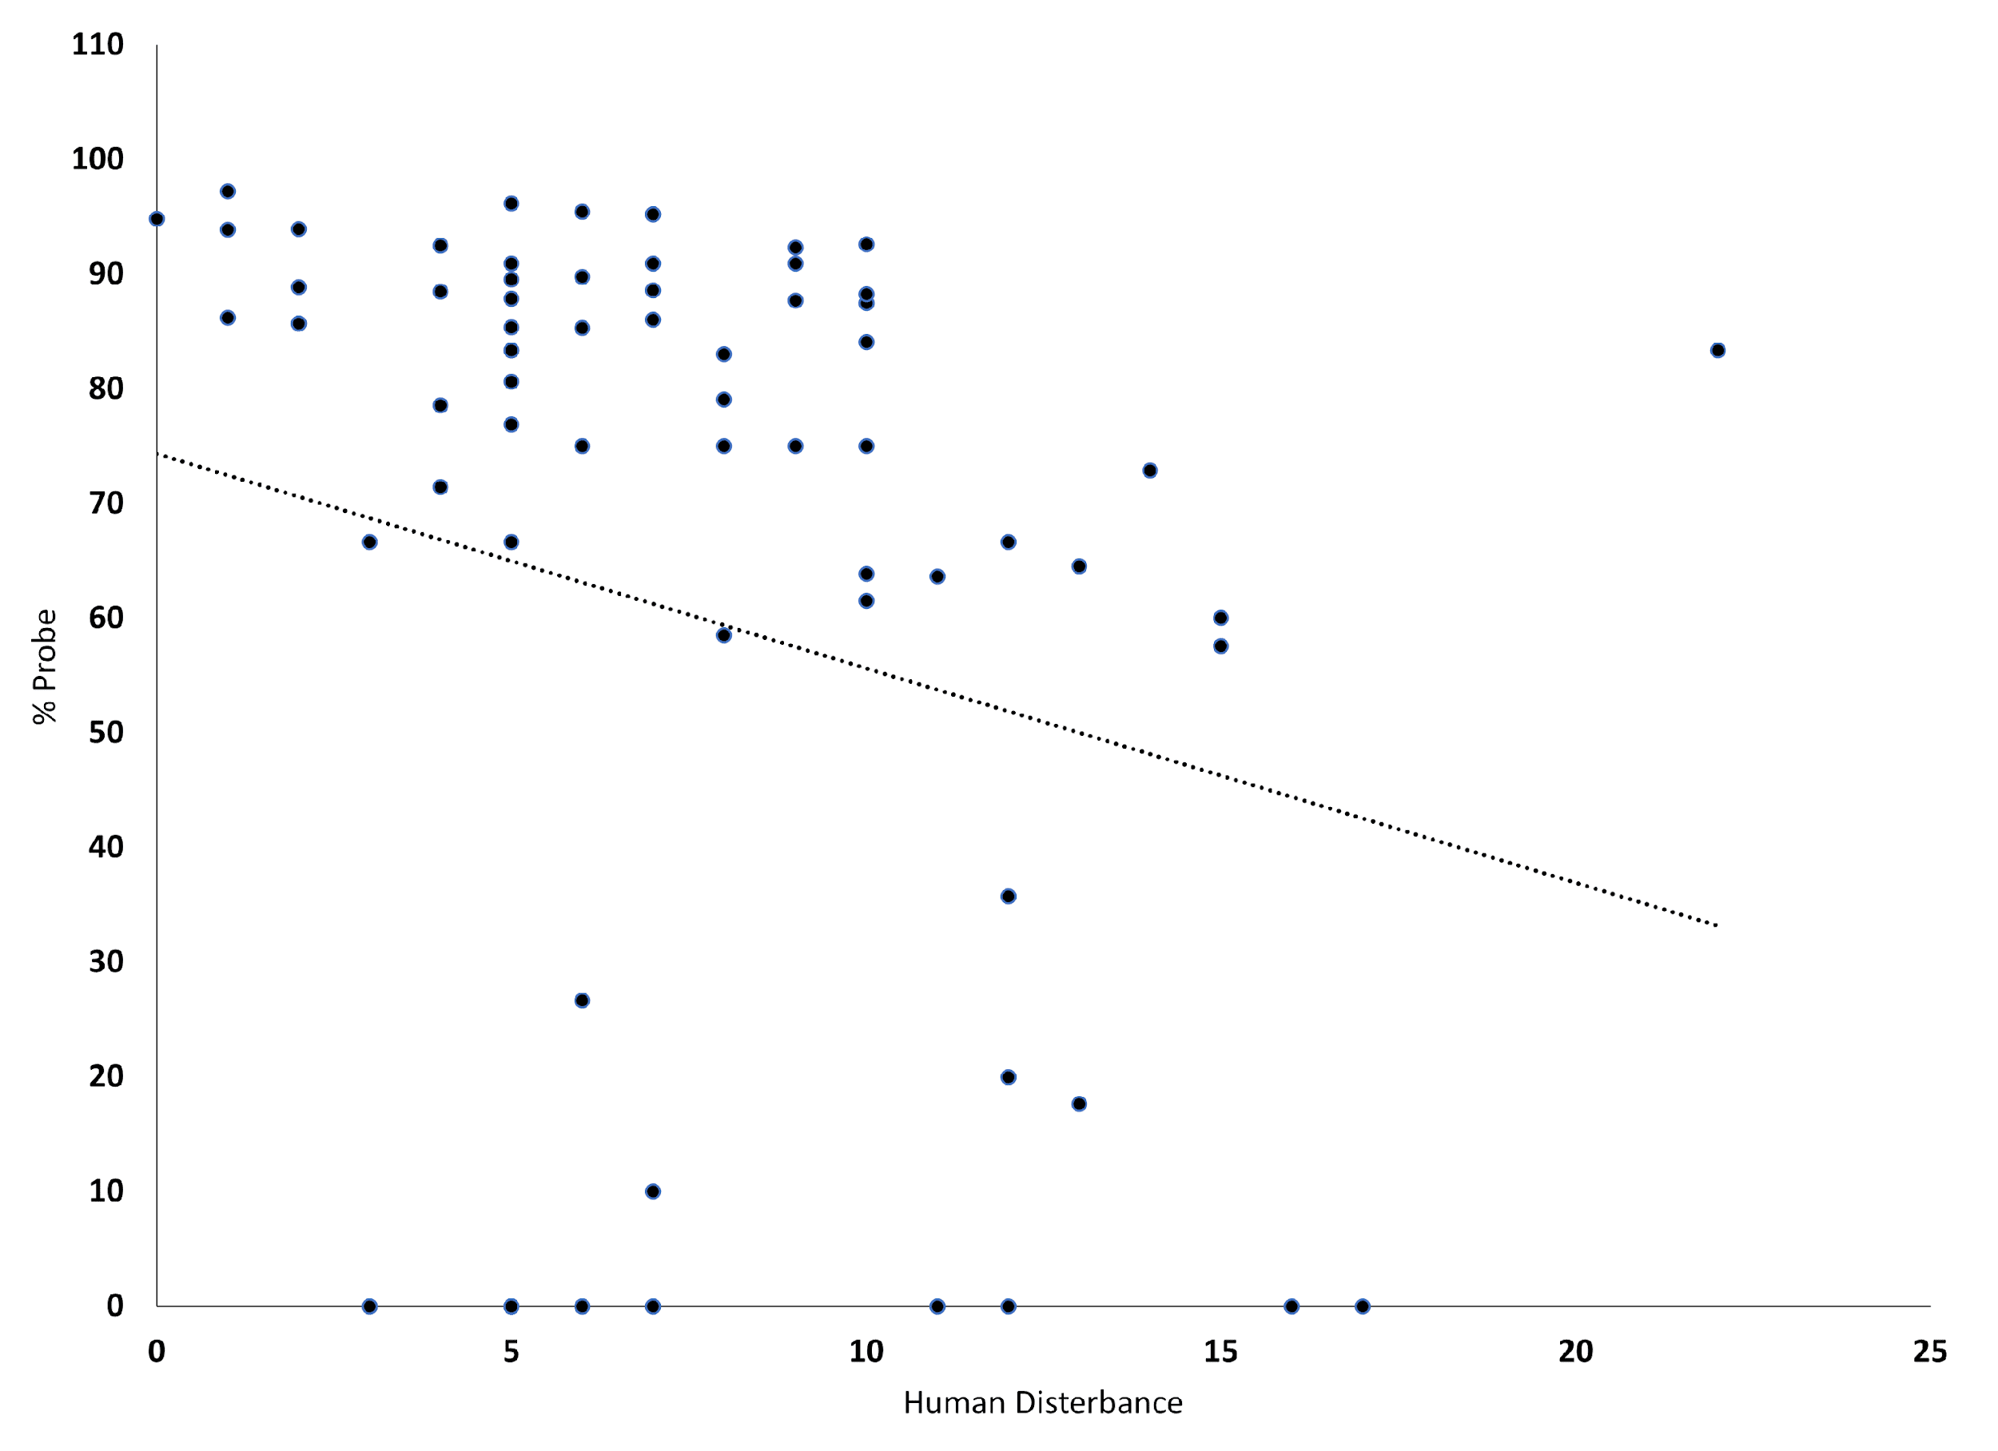
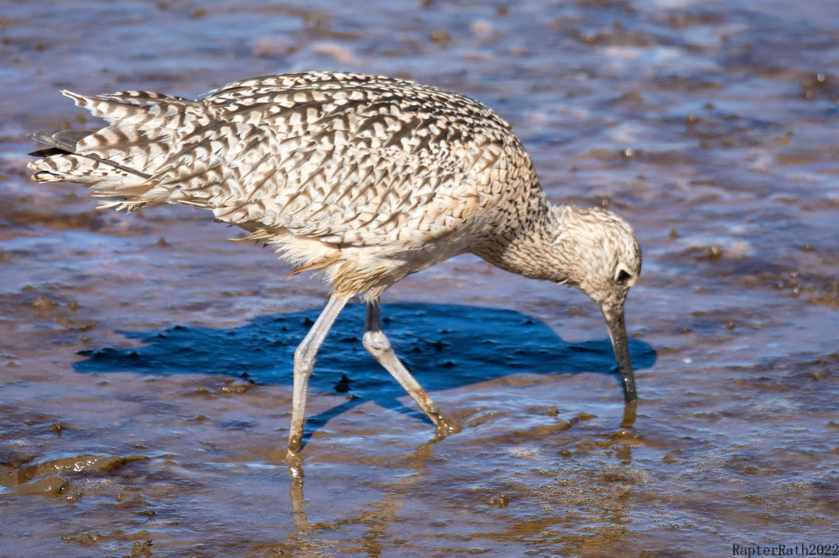
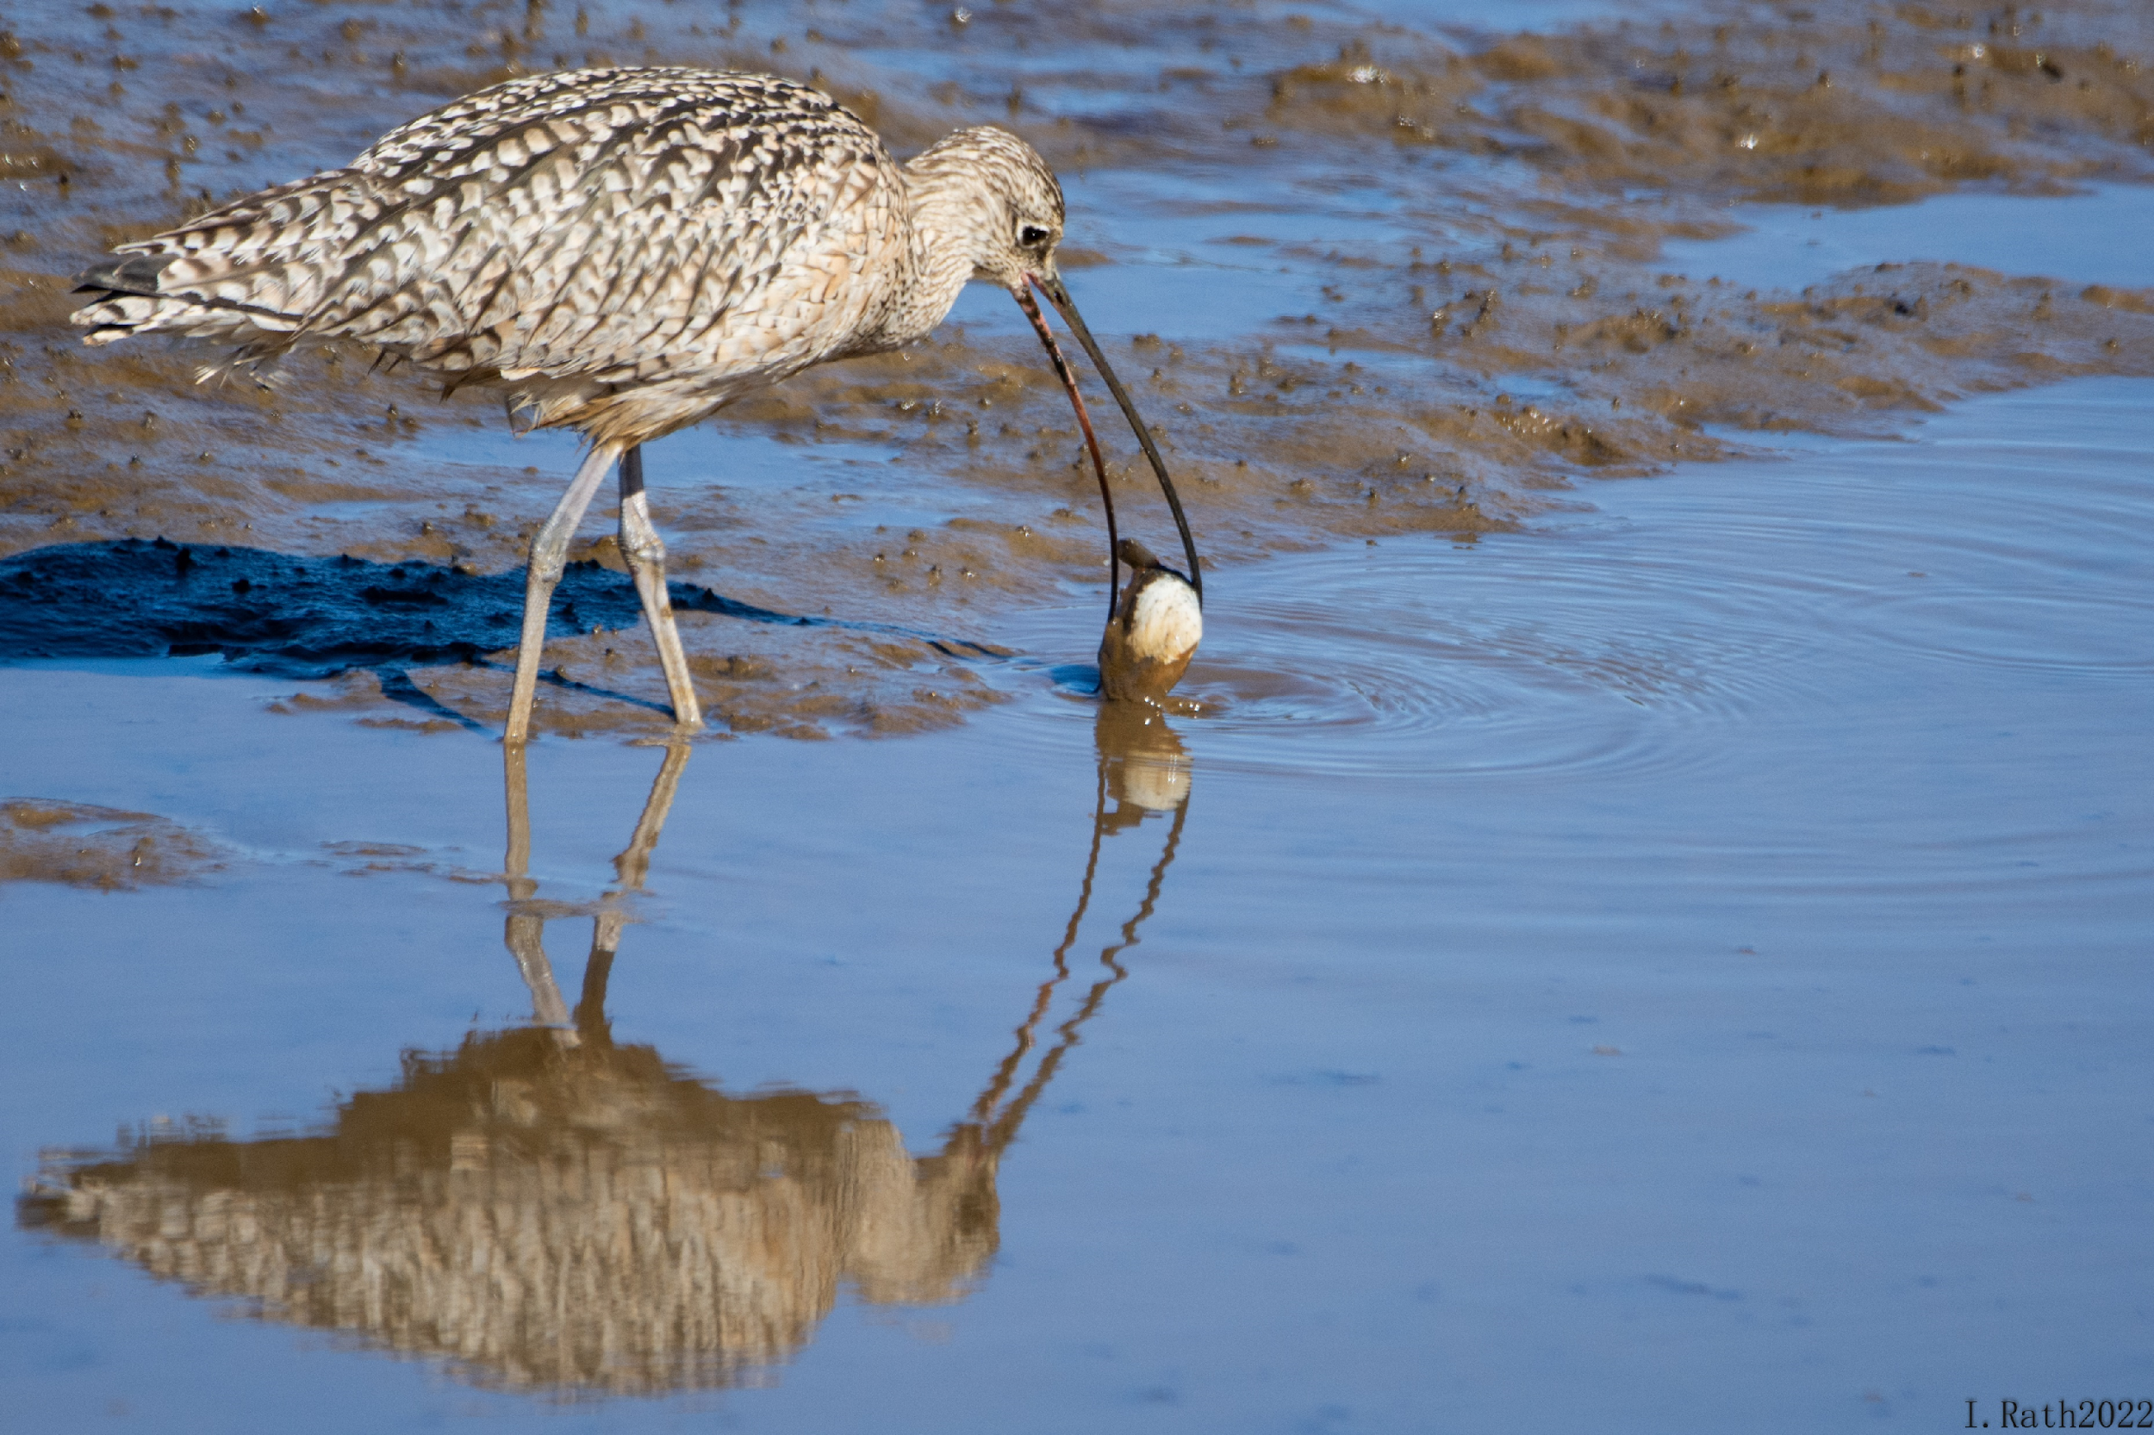
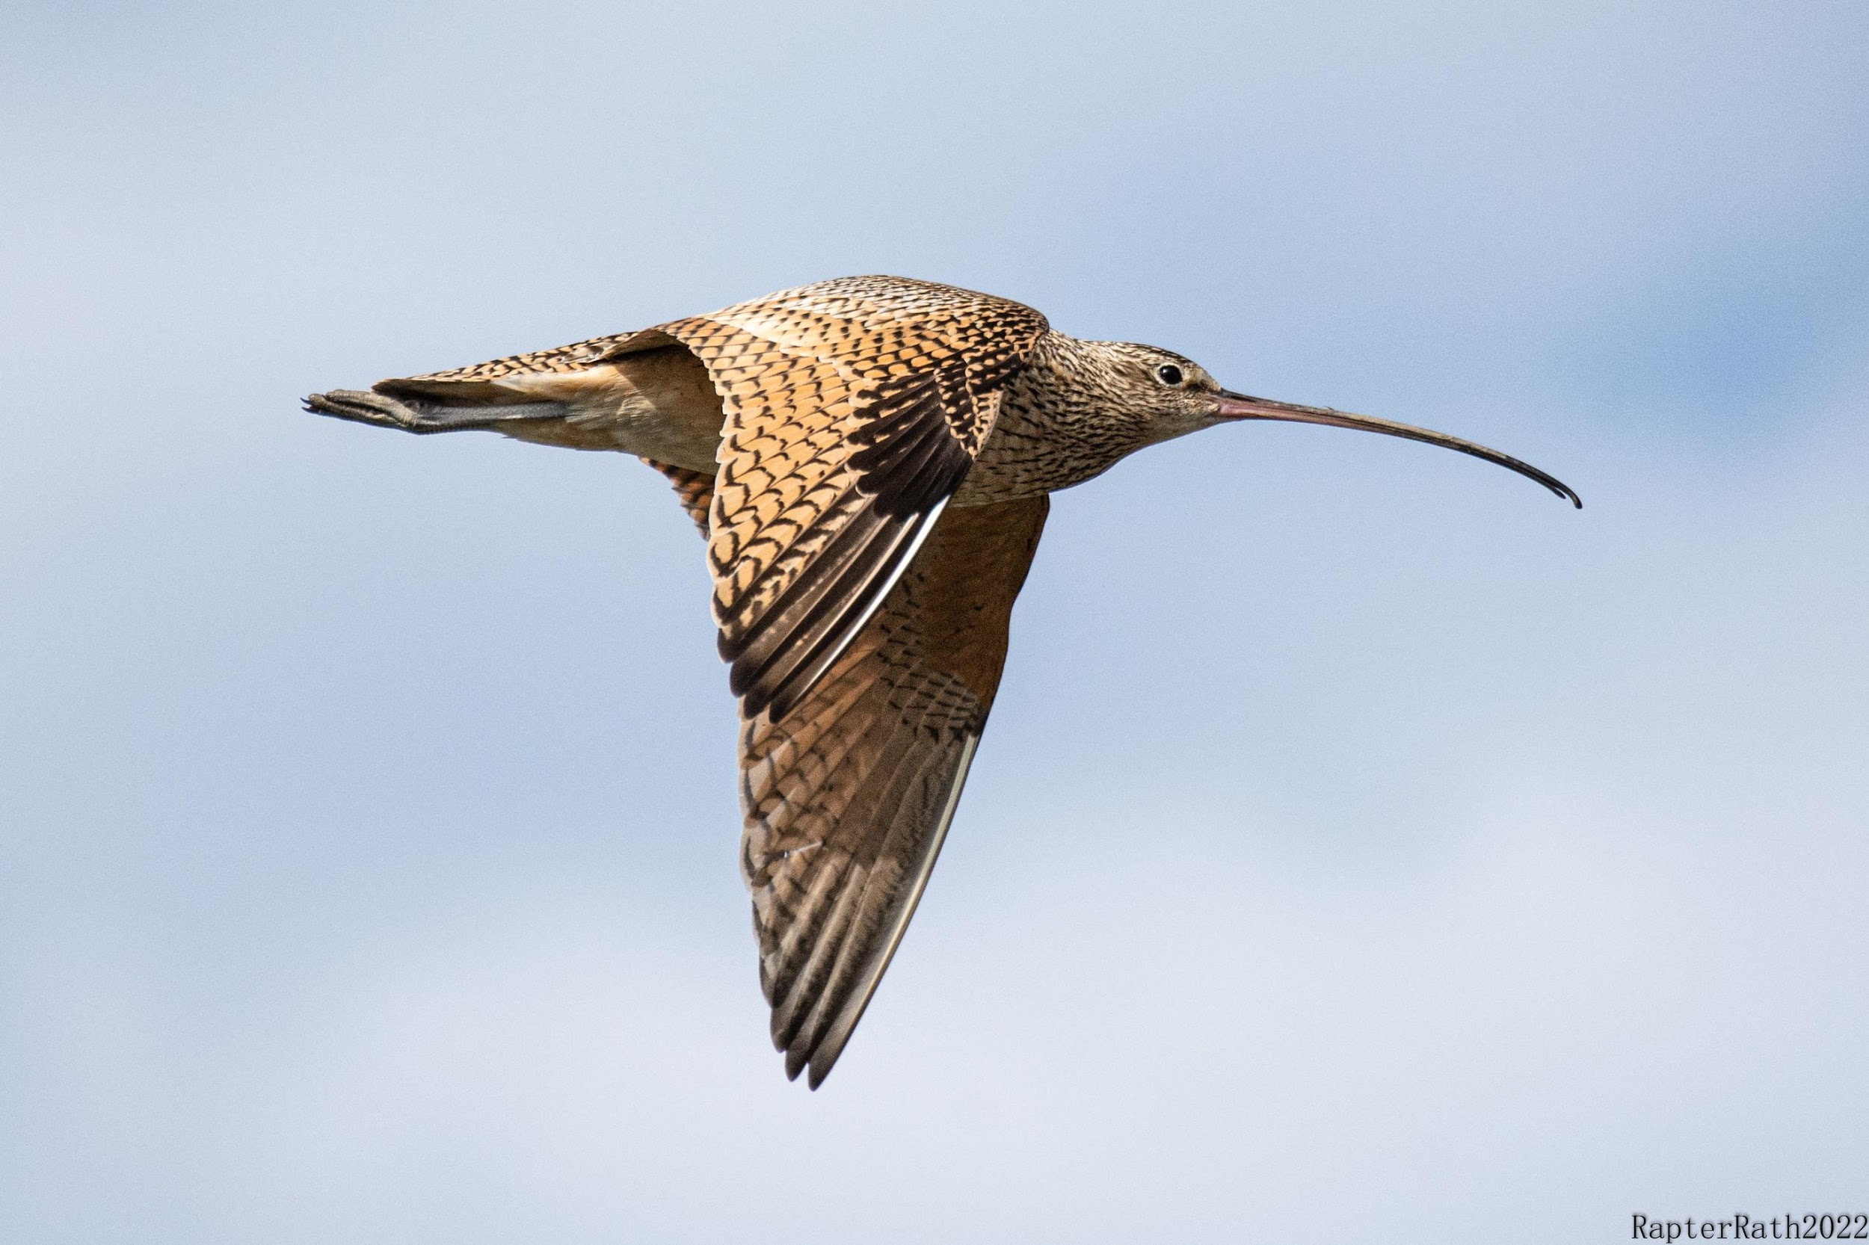
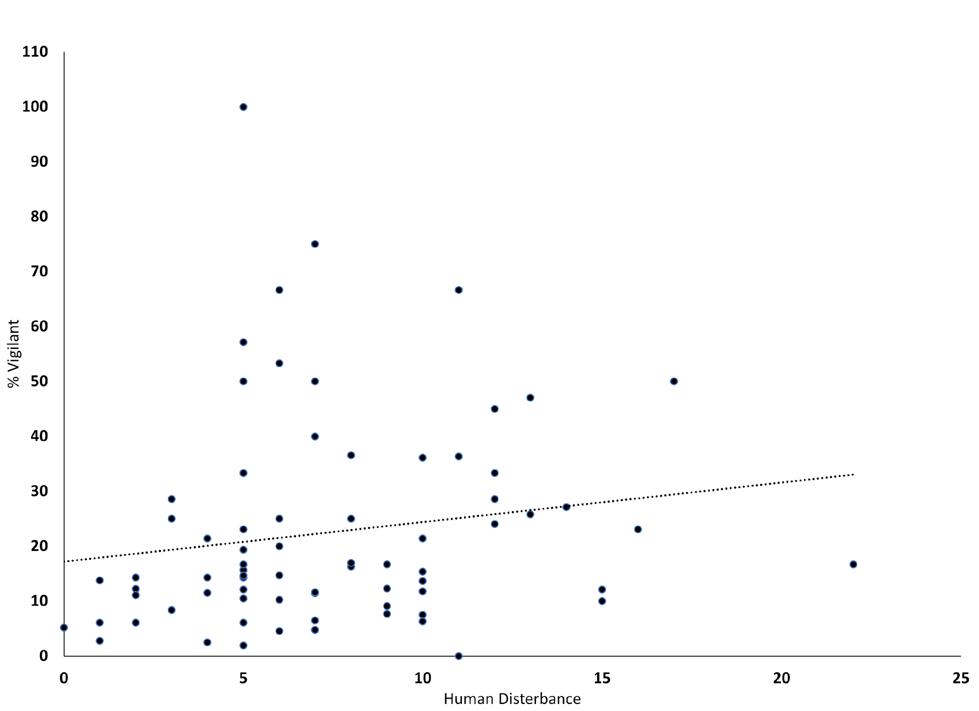
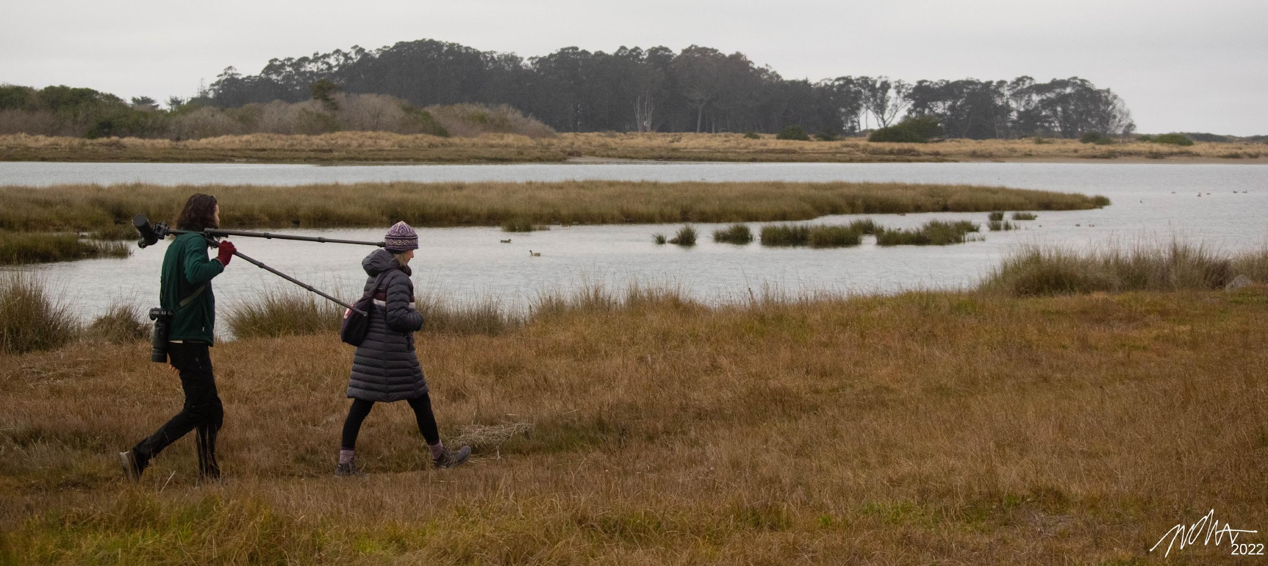
Human Disturbance Influences the Long-billed Curlew’s Foraging Behavior (Numenius americanus)
Isaac Rath
Department of Wildlife, Cal Poly Humboldt
INTRODUCTION: There have been a lot of studies done on the Long-billed Curlew around the Humboldt bay (Colwell and Mathis 2001, Leeman et al. 2001, Mathis et al. 2006) however not many on the impact of humans on them. This study looked at whether humans are affecting the foraging behavior of the Long-billed Curlew around Humboldt bay.
DIET: The Curlew has a wide-ranging diet including bivalves, marine worms, ghost shrimp, and crabs (Leeman et al. 2001). When Curlews find their food, they can spend up to 4 minutes with one prey item and if it is muddy, they will spend time washing it in water before eating it (Leeman et al. 2001, Stenzel et al. 1976).
With the Outlier (R²=0.05, P = 0.07)
Without the Outlier (R²= 0.07, P = 0.02)
RESULTS: After analyzing the data using linear regressions, I realized that there was an outlier that was throwing all the data off. Therefore, I ran the regressions twice; once with the outlier and one time without. With the outlier included in the analysis, I found no relationship between humans and probing behavior (Fig. 1, R²=0.05, P=0.07). However, when the outlier was excluded, probing significantly decreased in the presence of humans (Fig. 1, R²=0.07, P=0.02). Similarly, preening was negatively related to humans without the outlier (R²=0.06, P=0.04), but that relationship diminished when the outlier was included in the analysis (R²=0.03 and P=0.11). Finally, there was no correlation between Curlew vigilance and human disturbance with or without the outlier included in the regression (Fig. 2, R²=0.02, P=0.18; R²=0.04, P=0.11).
Probe
Figure 1: Long-Billed Curlews foraged less in the presence of human disturbance, but this relationship was lost with the inclusion of a single outlier.
STUDY AREA: There were two study areas, one was the McDaniel slough, and the other was the Elk River estuary. These two areas were chosen because of their proximity to walking paths and for the abundance of curlews that are in the area.
METHODS: For this study, I did a focal animal survey for the duration of 10 min. The observations were made at a minimum distance of 25m with the use of binoculars or a scope. During the 10 min period, I recorded four different behaviors.
Human Disturbance: This was the number of people walking/running/biking, cars driving by, and gunshots around the area of the curlew.
Vigilance: This was defined by when the Curlew stopped what it was doing and lifted its head and looked around.
Preen: This was anytime the Curlew would stop and adjust its feathers with its beak or feet.
Probe: This was defined by anytime the Curlew was actively sticking its bill into the tidal flat.
With the outlier (R²=0.02, P = 0.18)
Without the Outlier (R² = 0.04, P = 0.11)
Vigilance
DISCUSSION: The outlier was a situation where there was 1 min left in the survey and a group of 20 people came upon a feeding/probing curlew driving it off. This threw off the data analysis and therefore I am not using that data point. The results and this situation show that there is a correlation between the Long-billed Curlew and human disturbance. These results prove my original hypothesis. This would mean that we need to protect a greater area, so the Long-billed Curlew and other birds are not disturbed by humans. In addition, it may be better for people to go in smaller groups to further reduce the amount of disturbance we are causing to the wildlife in these areas (Pfister et al. 1992).
References
Colwell, M. A., and R. L. Mathis. 2001. Seasonal Variation in Territory Occupancy of Non-Breeding Long-Billed Curlews in Intertidal Habitats. Waterbirds: The International Journal of Waterbird Biology 24:208–216.
Leeman, L. W., M. A. Colwell, T. S. Leeman, and R. L. Mathis. 2001. Diets, Energy Intake, and Kleptoparasitism of Nonbreeding Long-Billed Curlews in a Northern California Estuary. The Wilson Bulletin 113:194–201.
Mathis, R. L., Colwell, M. A., Leeman, L. W., & Leeman, T. S. (2006). 2006. Long-billed Curlew distributions in intertidal habitats: scale-dependent patterns. Western Birds 37.
Stenzel, L. E., H. R. Huber, and G. W. Page. 1976. Feeding Behavior and Diet of the Long-Billed Curlew and Willet. The Wilson Bulletin 88:314–332.
Pfister, C., B. A. Harrington, and M. Lavine. 1992. The impact of human disturbance on shorebirds at a migration staging area. Biological Conservation 60:115–126.
Acknowledgments: Sean Mahoney with his advice throughout this project, Mark Colwell for helping in getting my initial idea, Susie Rath for her help surveying and proofreading, Mike Rath for help getting photos, and Kaylee O'Brien-Correia for her enthusiasm in listening to me think out loud.
Figure 2: Long-billed Curlew vigilance did not change under more human disturbance in the area, with and without the outlier.

