Slide 1
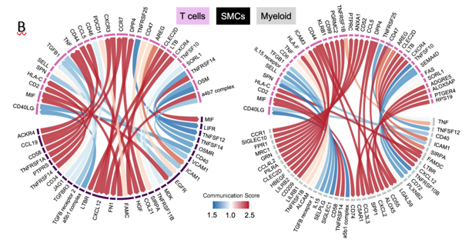
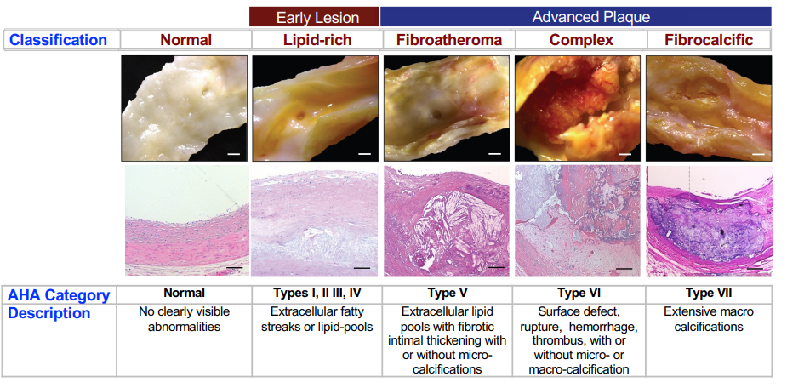
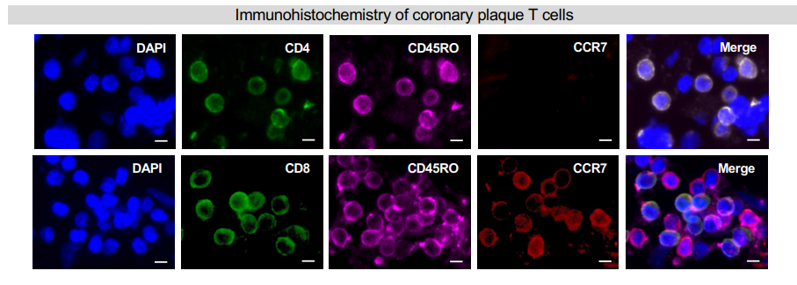
Deciphering the Crosstalk within Human Coronary Atherosclerotic Plaque
Annie Jensen, Stefan A. Veizades, Joshua J. Quintanilla, Dr. Charles Chan, and Dr. Patricia K. Nguyen, Department of Medicine (Cardiovascular Medicine), Stanford University, CA, USA
We are investigating the cross-talk between T cells and the coronary atherosclerotic plaque microenvironment using single-cell technologies. Coronary disease is a chronic inflammatory disorder characterized by plaque build-up in arteries. Understanding the signaling pathways between T cells and other nonimmune cells within the atherosclerotic plaque could lead to the development of novel therapies to prevent atherosclerotic progression and its potentially deadly complications, (i.e., heart attacks and strokes). After dissecting human coronaries from donor hearts, we digested the coronary arteries into single cell suspension, sorted cells using FACS (fluorescence-activated cell sorting), and used 10X genomics to analyze their single-cell gene expression. Our preliminary analysis of the ligand-receptor interactions suggests that T cells communicate with myeloid and smooth muscle cells within the plaque. Analysis by immunohistochemistry reveals that memory T cells predominate in the plaque, suggesting T cells may have been recruited by interaction with myeloid that display cognate peptide epitopes that transform naive T cells into memory T cells. In vitro analysis of the interaction of T cell cytokines with smooth muscle cells shows upregulation of proinflammatory and profibrotic pathways. In conclusion, we find that T cells appear to communicate with myeloid and smooth muscle cells within coronary atherosclerotic plaques.In the future, we plan to validate a model in-vitro that could lead to the discovery of therapeutic treatments for atherosclerosis.
Abstract
0
Methods
Results
FIGURE 1. Flow chart of methods used: tissue digestion, FACS, and 10x.
FIGURE 3.A. Mapping of phenotypes found in Alpha Beta T cells in plaque. B. Computational ligand receptor analysis using the known interactions from gene expression profile gained by 10x 3 prime gene sequencing data.
Coronary artery disease (CAD) is a leading cause of mortality and mobility globally.^{1,2}
CAD is caused by a buildup of plaque in the vascular smooth muscle cells in the medial- intima layer of arteries of the heart.^{1,4}
Atherosclerotic plaque is a complex cellular niche composed of lipids, immune cells, monocytes, and smooth muscle cells.²
A necrotic core forms due to the inflammatory response caused by the build-up of macrophages, lipoproteins, and extracellular lipids.³
A synthetic fibroproliferative phenotypic switch of the smooth muscle cells occurs, causing them to proliferate and migrate.³
Smooth muscles cells within the fibrous cap produce extracellular matrix proteins, with the synthetic phenotype leading to plaque stability.³
The environment surrounding the plaque is also involved with the activation of proinflammatory cytokines, among other factors, leading to the progression of the disease by initiating the recruitment of macrophages.^{3,4}
Increased activation of effector or memory T cells are correlated with disease progression.⁵
Activated T cells in the atherosclerotic plaque are primarily effector or memory T cells, while naïve T cells are not commonly found.⁵
Introduction
Results
-Based on analysis of the plaque transcriptome, the majority of T cells found in the plaque are effector memory T cells that show markers of activation and cytokine secretion.
-Following ligand-receptor analysis suggests T cells communicate with other cells within plaque, including smooth-muscles cells and macrophages.
- Gene expression analysis indicates upregulation of proinflammatory and profibrotic pathways after exposure off smooth-muscle cells to T cell cytokines
- Our future direction is to validate these findings with in-vitro assays and modulate the pathways to discover new therapeutic strategies to treat atherosclerosis.
Conclusions
CSU-LSAMP is funded through the National Science Foundation (NSF) under grant #HRD-1302873 and the Chancellor's Office of the -California State University. CSU-LSAMP is funded through the National Science Foundation (NSF) under grant #HRD-1302873 and the Chancellor's Office of the California State University.
1. Basatemur, GL., HF. Jørgensen, MCH. Clarke, MR. Bennett and Z. Mallat (2019). Vascular smooth muscle cells in atherosclerosis. Nature Reviews Cardiology 16(12): 727-744.
Sukhovershin, R. A., N. E. Toledano Furman, E. Tasciotti and B. H. Trachtenberg (2016). Local Inhibition of Macrophage and Smooth Muscle Cell Proliferation to Suppress Plaque Progression. Methodist DeBakey cardiovascular journal 12(3): 141-145.
2. Berasain, C. and MA. Avila (2014). Amphiregulin. Seminars in Cell & Developmental Biology 28: 31-41.
3. Yurdagul, A. (2022). "Crosstalk Between Macrophages and Vascular Smooth Muscle Cells in Atherosclerotic Plaque Stability." Arteriosclerosis, Thrombosis, and Vascular Biology 42(4): 372-380.
4. Padgett, LE, Araujo, DJ, Hedrick, CC, Olingy, CE. (2020). Functional crosstalk between T cells and monocytes in cancer and atherosclerosis. J Leukoc Biol. 108: 297– 308.
5. Robertson, A.-K. L. and G. K. Hansson (2006). "T Cells in Atherogenesis." Arteriosclerosis, Thrombosis, and Vascular Biology 26(11): 2421-2432.
Acknowledgments
References
We thank the CIRM Program, CIRM Grant number CIRM Bridges 3.0 #EDUC2-12620, for making this research possible, as well as, Cal Poly Humboldt University and Stanford University. A special thank you to Dr. Jenny Cappuccio, Dr. Amy Sprowles, Dr. Brigitte Blackman, and many more who made this program possible.
FIGURE 2. Top: Histological view of plaque progression. Below: Immunohistochemistry of coronary T cells. DAPI: stains nuclei (blue), CD 8: stains CD8 positive suppressor T cells (green), CD45RO: stains memory T cells (pink), and CCr7: stains Naïve T cells (red). Majority of T cells expressed in plaque have memory effector phenotype, which lack of expression of CCr7.

