Slide 1
Streams Across Landscapes (SAL)
A new method for modeling stream flow in small watersheds
Jim Graham, PhD
Humboldt State University
Arcata, California, USA
JULIA Petreshen
Thomas Gast & Associates Environnemental Consultants
Arcata, California, USA

Slide 2
Why We Created SAL
The amount of water, and it’s characteristics, are key to determining emigration, spawning, rearing, and out migration potential for salmonids.
Modeling allows us to recreate historic stream flow and for scenarios in the future
Existing stream flow modeling approaches require calibration to a stream flow gauge
Not always available
Shifts model off reality unless diversions are accounted for
Need a modeling approach that:
Does not require calibration to a stream gauge hydrograph
Allows for accounting for diversions and lakes

Slide 3
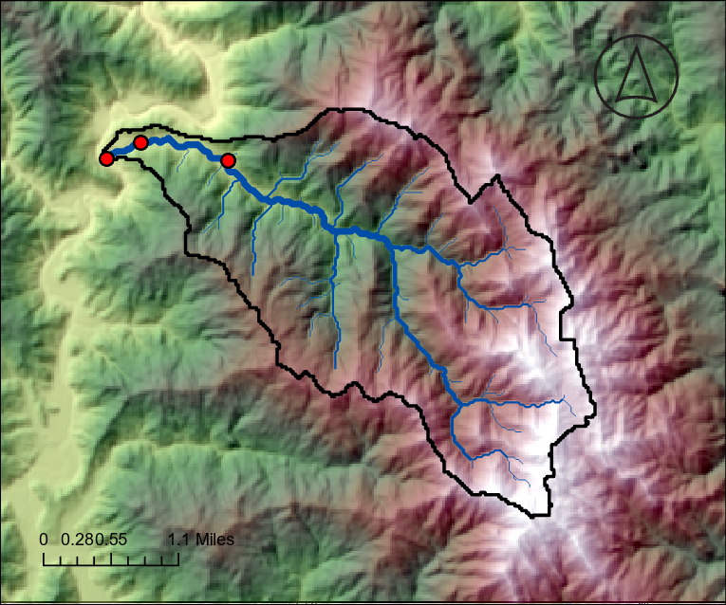
Elder Creek Watershed
Confluence with Tributary
Gauge Station
Confluence with Southern Fork of the Eel River

Slide 4
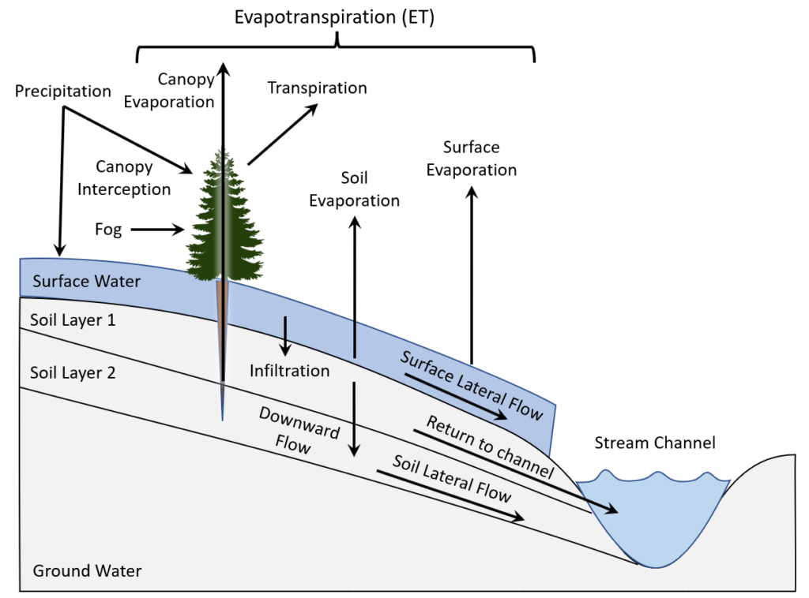

Slide 5
Approach
Created within BlueSpray
GIS application originally from SchoonerTurtles, Inc.
Combines open source libraries with custom code to create a flexible development environment
Java based application
Runs on MS-Windows, UNIX, Linux, Mac
Standard file formats for inputs and outputs
TIFF, Shapefiles, CSVs, etc.
Creates web pages to visualize results

Slide 6
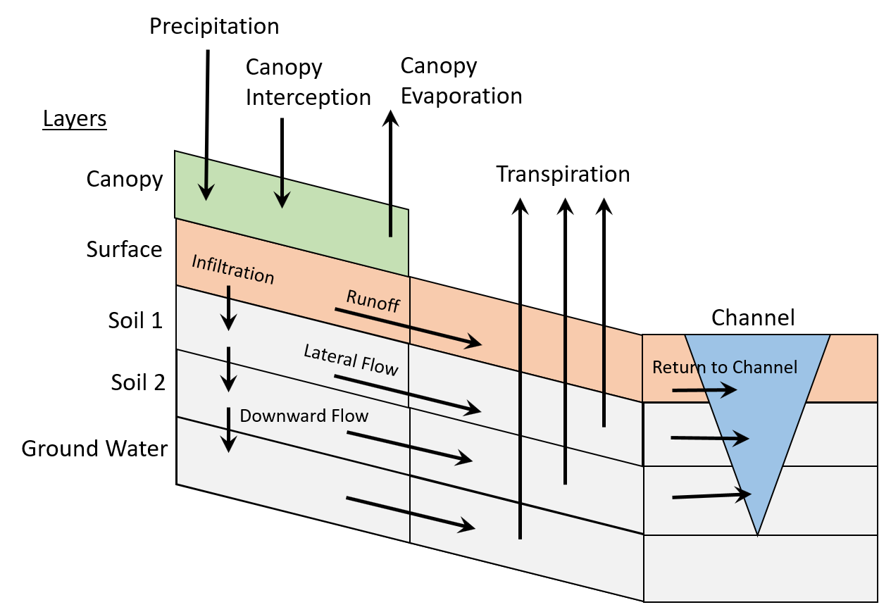

Slide 7
Data
Digital Elevation Model (DEM)
30 meters works well
All cells within the watershed, except lakes, flow to the pour point
Pour Point for Watershed
Weather Data
Precipitation
Required for ET: Wind, Temp, Humidity
Solar Radiation: provided or automatic
Stream Gauge Data (optional)
Cover type (optional)
Types provided for National Land Cover Data (NLCD)
Soil Data (optional)
BlueSpray includes features to create soil layers from SSURGO polygons

Slide 8
Flexibility
Any spatial resolution:
30 meters seems to work well
Weather and discharge data at 5 minutes to daily
Time cycles from 5 minutes to daily
Any number & depth of soil layers:
4-6 layers for first 2 meters
Cover type and age (converted to height)
Soil type and rock proportion at various depths

Slide 9
Elder Creek Model
Complete weather data at 15 minute intervals
Precip, Temp, Wind Speed, Humidity, Solar Radiation
USGS stream gauge at 10 minute intervals resampled to 15 minute
Cover type from NLCD
Age from LEMMA
Cover Type from NLCD
Cover Age from LEMMA
Soil Data from SSURGO: Type and Proportion Rock

Slide 10
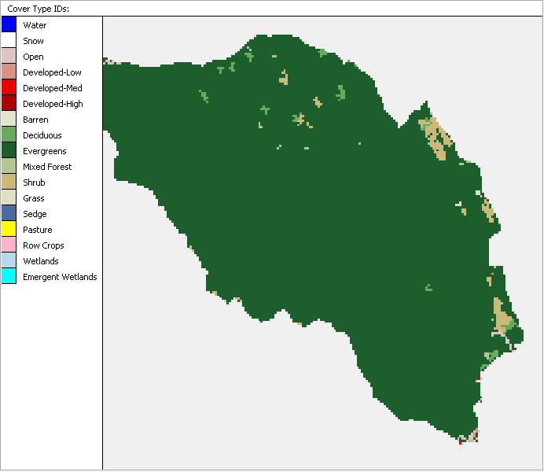
NLCD Cover Type Data
Elder Creek is almost all evergreen forest

Slide 11
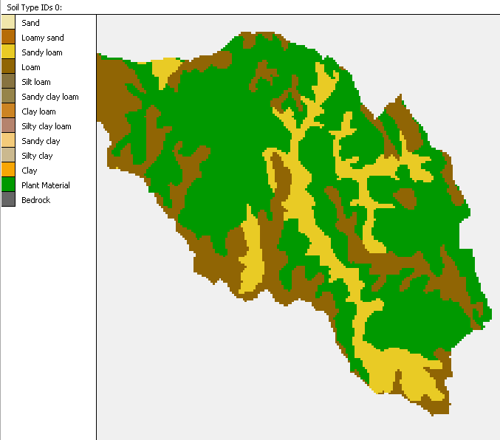
SSURGO Soil Type Data
Each soil type has different properties for moving water
First soil layer is dominated by plant material

Slide 12
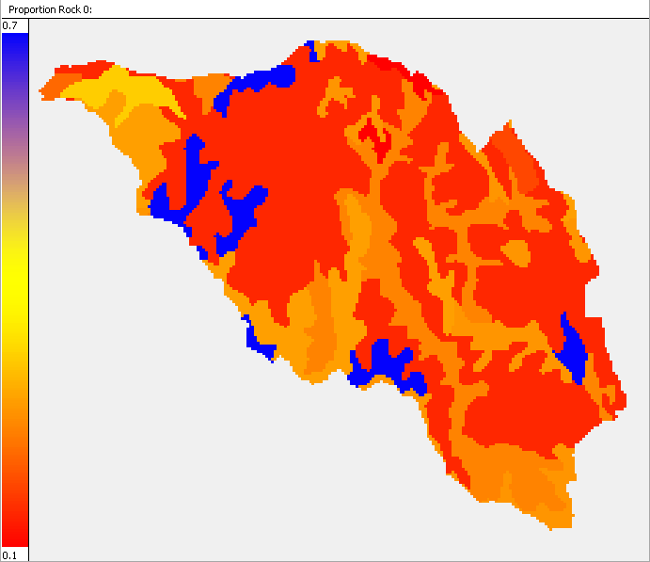
Proportion Rock
Flow is restricted by rock
Notes:
Run video example

Slide 13
Results
Best Nash–Sutcliffe Model Efficiency Coefficient:
0.8764
For 2015 through 2017

Slide 14
Additional features
Diversions
Move water from streams to surface, etc.
Modifications
Change rasters at points in time
Simulate harvests, plantings
Lakes
Simulate storage and evaporation

Slide 15
Next Steps
Data:
Developing cover type and age based on LiDAR and NAIP data for entire Eel River watershed
Validation against a system that is dryer than Elder Creek
Additional Features:
Macropores
Springs (upwelling)
Snow?
Fog absorption?
Ground water level?
Testing, documentation improvements, etc.

Slide 16
Acknowledgements
Thanks to:
VELMA team at the EPA
Dr. Lawrence Dingman for the textbook Physical Hydrology
Angelo Coast Range Reserve:
University of California Natural Reserve System
Example Outputs:
http://gsp.humboldt.edu/websites/watersheds/ElderCreek/
Questions?
James.graham@humboldt.edu

