Slide 1
Twelve page template - outer cover
CHECK ‘EM OUT
PUNK
INFLUENCE
12
4
1
Page 12 (back cover)
1
Page 1 (front cover)
Bad Brains, Afro Punk Band
Bindas, Kenneth J. “‘The Future Is Unwritten’: The Clash, Punk and America, 1977-1982.” American Studies, vol. 34, no. 1, 1993, pp. 69–89, http://www.jstor.org/stable/40642496. Accessed 24 Apr. 2022.
Blogging, P.I.S., et al. “Common Punk Rock Ideologies and Philosophies.” Punx In Solidarity, 15 Sept. 2017, https://punxinsolidarity.wordpress.com/2013/11/02/common-punk-rock-ideologies-and-philosophies/.
“Malcolm McLaren.” Encyclopædia Britannica, Encyclopædia Britannica, Inc., https://www.britannica.com/biography/Malcolm-McLaren.
A look into 70’s and 80’s Punk subculture
Changing American Society/ The Echoes Of Punk
Notes:
Twelve page template - outer cover

Slide 2
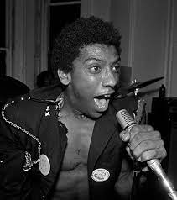
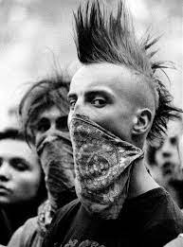
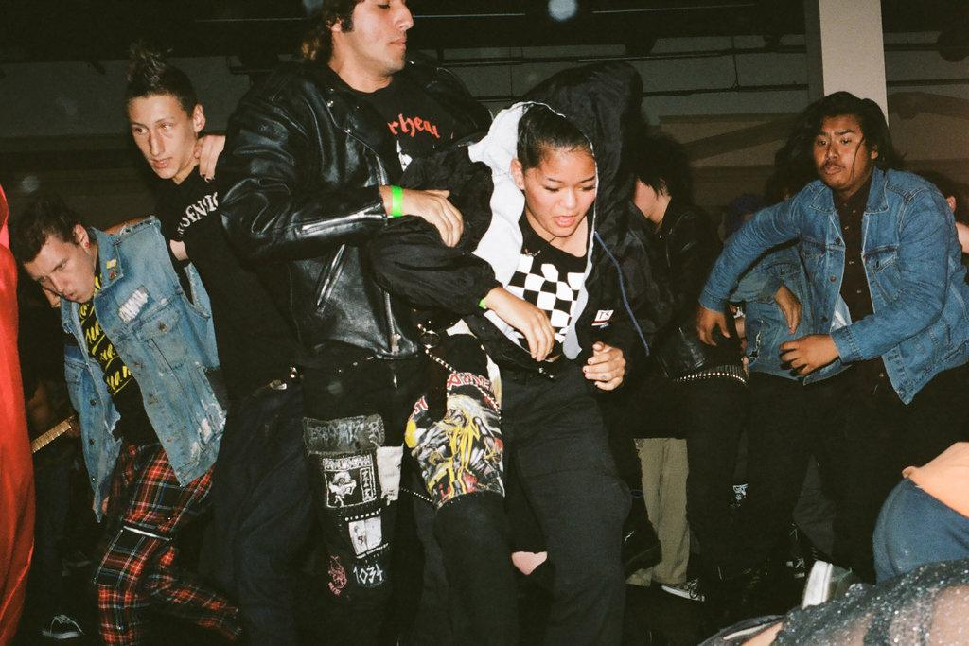
Twelve page template - inner cover
CHOICE
NOW
!
CHOICE
the scene
Page 2
2
10
11
Page 11
Ideologies
8
influence
Rebellion, anti-authoritarianism and individualism
Bad Brains
With band like All Time Low, and Vans Warped Tour in the ear of Punk goes Pop. The continuation of shock value and a blend of the punk aesthetic with mainstream culture. Once again raising the question of “who is punk” and “what makes you punk”.
Contrasted against the ban Against Me! Which is more “true to its origins” as a punk trans band. Addionaly the rise of more queer and POC punk bands has uncreased sence the 70s. With bands like She/Her/Hers, SPEW, The Younger Lovers, and many more.
The Punk Scene is based on the ideas of social protests. Found in the 70s with tried and feed up youth of current economic and political state of their country.
The scene has political punks, religious (christian,Islam,ic, kirsha) punks, and non political punks.
The ones most commonly talked about are anarcho-punks, neo-nazi punks, nihilist punks, and straightedge punks. Less common groups are liberalism punks, socialist punks, and conservative punks.
Notes:
Twelve page template - inner cover

Slide 3
Twelve page template - middle leaf (face same side as outer cover)
DISORDERLY
3
DISORDERLY
VOICE
VOICE
9
3
Page 10
Page 3
Influence
Ideologies
A criticism of the government commonly heard, oftentimes anti-military. Condemning genocides and acts of violence by the State. Listening to “Die for your government” by Anti-Flag, the rejection and questioning of authority is seen. The with line such as “you're going to die for your government you're going to die for your country that shit”, criticizing the Vietnam War. Discussing the use of biochemicals on people by US corporations.
Went on to influence rock bands of the 90s like Green Day, Rancid, and Offspring which lead to punk becoming mainstream once more.
That being said it is important to note that not everything in the screen around this time was great. The focus was on white abled bodied heterosexul people
That the government is going to look at these atrocities caused by their hand and say they don't know that it happened. Effectively turning it’s back on you
Class based injustice are addressed, due to punk being born during a time of economics crisis in working class in UK and middle class youths in US. In songs like “Kill The poor” by the dead Kennedys, a mockery of how the US government addressing the issue is made.
Twelve page template - middle leaf (face same side as outer cover)
Notes:
Twelve page template - middle leaf (face same side as outer cover)

Slide 4
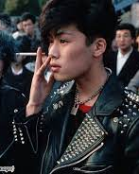
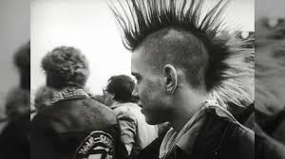
Twelve page template - middle leaf (face same side as inner cover)
SYMBOLS
SYMBOLS
DISORDERLY
DISORDERLY
Page 4
4
Page 9
Influence
Created a genre of music that continues to expand and express political issues in a way that traditional means can not.
Deface and the intend misuse of oppressive symbols, like the swastikas, symbols is often done by punks to show the ugly side of a state or nation
Riot Grrl and Pussy Riot, both address feminism and anti-capitalism. It’s do to punks origins in social political activism and angry sound that made these movements.
Throughout the hard core screen influences of punk are found. In the leather and makeup of 80s hair bands, emo, and pop punk. The influence of punk is still seen today with the association of the anarchy symbol and marxist.
anarchy symbol
Notes:
Twelve page template - middle leaf (face same side as inner cover)

Slide 5
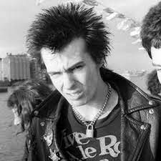
Twelve page template - inner leaf (face same side as outer cover)
“COUTURE”
FASHION
7
4
2
FASHION
Fashion
A padlock and chain necklace was gifted to Sid Vicious by Chrissie Hynde of The Pretenders, a nod to 1950’s literature of the “ball and chain” on UK’s working class. We see a new wave of the necklace today with alt fashion.
FASHION
Punk Fashion rejection of social norms in favor of self expression and DIY clothes. Wearing pinned together shirts and rubber. Adding spikes, chains, and fishnets to patched pants and jackets . Colored and spiked hair was key to the look, but some people would buzz it. Facial and other piercings.
The rejection of everyday formal wear and the hippies style. Instead opting for skinny ties and lapels, straight-legged pants, leather or army jackets, tennis shoes, biker boots, and ripped t-shirts.
Often times clothing crossed the gender line of expression, men dressed more femmine, and women dressed more mascline, creating a unisex look.
Mclaren
Notes:
Twelve page template - inner leaf (face same side as outer cover)

Slide 6
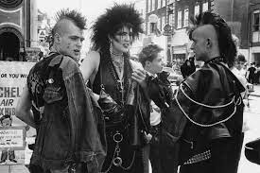
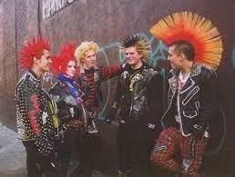
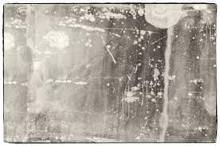
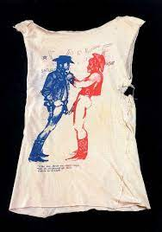
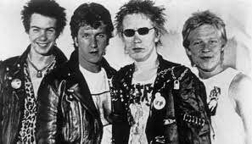
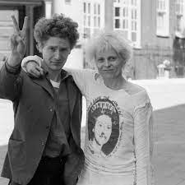
Twelve page template - inner leaf (middle pages)
“COUTURE”
6
5
Page 6
7
Fashion
Vivienne Westwood and Malcolm Mclaren opened a clothing shop, or couture, called “Let It Rock” in 1971, but renamed the store to “SEX” in 1975. With shirts of cowboys naked for the waist down, mikey mouse and minnie mouse fucking. She continues to influence fashion today. Her 1991 Pirates Runway with upcycled clothes, and 2014 re-edition Buffalo hat, stuck conservis and media attention. As for Mclaren a source of inspiration for a number of Westwood’s shows, and the manger of the Sex Pistols.
A padlock and chain necklace was gifted to Sid Vicious by Chrissie Hynde of The Pretenders, a nod to 1950’s literature of the “ball and chain” on UK’s working class. We see a new wave of the necklace today with alt fashion.
Notes:
Twelve page template - inner leaf (middle pages)

Slide 7
Overview, explanation, and visual map
Explanation
Below are two methods to determine the pagination order for your zine slides. For both, the total number of pages (which we’ll refer to as n) must be divisible by 4 because there are four pages on one piece of paper, front and back. The total includes the covers (back and front) and the insides of the covers. If this seems confusing, that’s because it is. Try printing out the template with the numbers and then construct the folded booklet to see how it all comes together.
Visual method (if you like seeing things laid out)
Create the total number of pages you want in your zine (this is our n). There are two pages per slide, so if you have a 12-page zine, you will need six slides.
Start numbering the slides starting with the right half of the first slide.
Continue numbering 1 through n following the green arrows to the left. As you move down the slides, this alternates between the left and right halves, with the odd numbers being on the right and the even numbers being on the left.
Once you reach the last slide, continue numbering with the next page being the right half of that last slide (so for a 12-page zine, you’d have 6 on the left half and 7 on the right half).
Continue numbering following the blue arrows. As you move back up the slides, this alternates between the odd numbers being on the right half of the slide and the even numbers being on the left.
If you’ve done it right, only even numbers will be on the left and only odd numbers on the right.
Formula method (if you like math)
First slide left is back cover (equal to n)
First slide right is front cover (page 1) - same as the slide number
Second slide left is same as the slide number
Second slide right is the inside of the back cover (n - 1)
Third slide left is two pages less than total (n - 2)
Third slide right is same as the slide number
Fourth slide left is same as the slide number
Fourth slide right is n - 3
Fifth slide left is n - 4
Fifth slide right is same as the slide number
Sixth slide left is same as the slide number
Sixth slide right is n - 5
Repeat if necessary! Notice that there is a pattern in the steps above, with the bold steps equalling the slide number.
12
1
Front of sheet 1
Step 1
Step 2
Front of sheet 1
2
11
Step 3
Step 4
Back of sheet 1
Back of sheet 1
10
3
Step 5
Step 6
Front of sheet 2
Front of sheet 2
4
9
Step 7
Step 8
Back of sheet 2
Back of sheet 2
8
5
Step 9
Step 10
Front of sheet 3
Front of sheet 3
6
7
Step 11
Step 12
Back of sheet 3
Back of sheet 3
Notes:
Overview,explanation, and visual map
This slide includes a visual representation of what each page of a 12 page booklet would look like and how a booklet with more pages can be constructed. Refer to the written explanation for a non-visual description of the two different methods.

