Slide 1
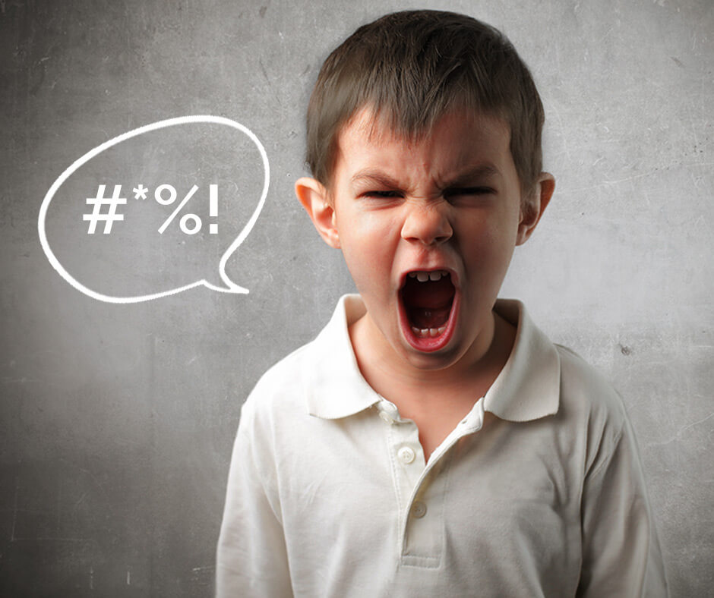
Understanding Cursing as a Transition Into Adulthood
Gaming In-Chat Discourse as Ritualized Offensiveness
The Ritual
The Separation Stage: begins when participants login online and join the game, within the Gaming boundaries the participant is separated from the physical world.
The Transition Stage: is defined by this linguistic based mental game overlaid upon the landscape of the actual video game.
The Final Incorporation Stage: comes when players exit the game and rejoin the physical world.
There are accounts of possible lasting effects of long-term repetition of the ritual, following the incorporation stage.
Test Interview’s
Competitive Cursing
Test Interview’s
1 Age Group Studied
Frequent gamers from ages 19 to 27 both male and female.
The Game
Begins with an aggressive insult.
The competition if most often between but not limited to two participants.
The player who achieves the best retort, and who wins this subtle cursing game is signaled by the undoing of the opponent’s mental calm.
The “winner” feels a sense of accomplishment at finding the right combination of insults and derogatory terms to cause true anguish to the other person.
Analysis
The competitive cursing is played out within the Transition stage of the ritual.
The anonymity aids to the freedom and encourages the competition.
Unanimously my male participants all use derogatory insults as a way to compete at offensiveness.
The most effective derogatory terms target race, ethnicity, and sexuality
3 Age Groups Studied
Highschool teens 16-18
College peers 20-22
Middle aged adults 54-59
Cursing Trends Conclusion
Inclusion and exclusion
The culturally created age requirement for cursing is created by rated R movies restricting based on age, sex shops restricting based on age, and even books being censored or avoided in schools. These influence parents to restrict their own children's use of curse words
This creates a sense of exclusivity around cursing, it’s only taboo for kids under 18. This encourages children to curse with friends in order to feel more grown up.
They are essentially “practicing” adulthood.
Comradery
One of the most common adjectives I collected was “camaraderie”. Cursing is an intimate way of speaking with friends, it expresses emotions more strongly, and creates a vulnerability based on the fact that what you're saying could be considered “vulgar” or “bad” thus speakers are trusting their friends not to judge their cursing and to reciprocate to some extent, showing loyalty.
Kids are in a vulnerable spot created by their age and their breach of cultural rules around this taboo. Trust is essential.
Cursing especially between friends creates a safe place to talk and strengthen kinship ties through trust and an absence of judgment (especially common in teen’s and twenties).
Code-switching
Within a community's language there is a diverse number of registers that all signal different status and meaning. Using the wrong register at the wrong time could mean harassment or even punishment especially to a kid under authority.
Swearing provides youths with a new register, however the significant taboo of underage swearing also teaches kids the valuable skill of knowing when to use this register and whom to use it with.
In my ethnographic study the 16-18 age group all state that they never use cursing with any authority figure and even try to hide their explicit music from parents. This is code-switching and is a necessary skill to learn in such a culturally diverse world with significant power dynamics.
Almost all of my 16-18 subjects mentioned that they mostly curse at school, perhaps partly due to the higher density of friends and allies, but also as a way to avoid the true authority figure of the parents. School becomes a linguistic playground from middle school through high school where taboo registers are tested, reviewed and learned.
Anger expression and release
The most common adjective I collected was “relief”. Cursing when alone is overwhelmingly used as a stress relief, and pain reducer. As people get older and into middle age they lose a lot of their kinship cursing and retain only their occasional stress cathartic cursing.
Cathartic swearing has been proven to actually reduce stress levels and heart rates when used and in some cases with occasional swearer’s it has been proven to actually reduce pain.
Protection of the Ritual
Creating a new language standard
Through frequent and consistent use of toxic language these participants create a new status quo within these boundaries. Human nature dictates that rarely will someone sit quietly and accept a constant stream of offensive insults, without either leaving or responding with a similar level of aggression. This makes it hard for gamers not to use the language when faced with an unending tide of cursing and derogatory terms.
Depersonalization
The terms and phrases lose their danger, and become less personal, it’s no longer a personal attack but encourages participation in the “culture”.
Hostile response against complaints
When a player raises a complaint or concern with specifically the language used, they face almost instantaneous ridicule and increased aggression from other players.
They become the target of competitive cursing.
Mental Impacts
Stress and Anger Relief
When asked the question “how has this culture changed you if at all?”, the biggest emphasis was n stress release through the ritual, mentioning lasting effects of feeling calmer.
The boundaries of the online gaming landscape provide a “safe space” to perform objectifying, and aggressive language while suspending the moral norm’s of the physical world.
The gamers are able to release aggression and stress in an aggressive but not physically violent or public way.
Depersonalization of Socially Charged Terms
Although people engaging in this ritual tend to lose sensitivity to derogatory terms, this also means they lose the negative effects of being triggered by or taking personal language of this nature.
Equipping gamers with a higher tolerance for triggering language.
Desensitization
While desensitization helps avoid hostile escalations, it also encourages incorporation of offensive language into everyday speech.
While this does vary by individual case, there is a in my interviews I detected a visible relationship between increased participation in the gaming ritual, and increased everyday offensive language use.

