Slide 1
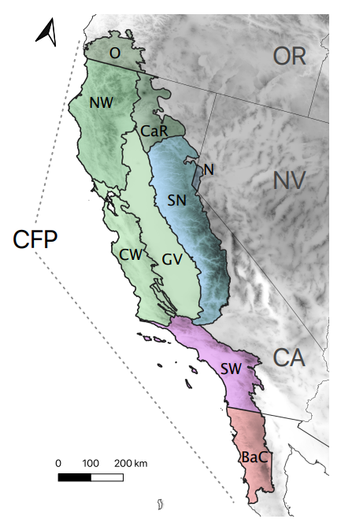
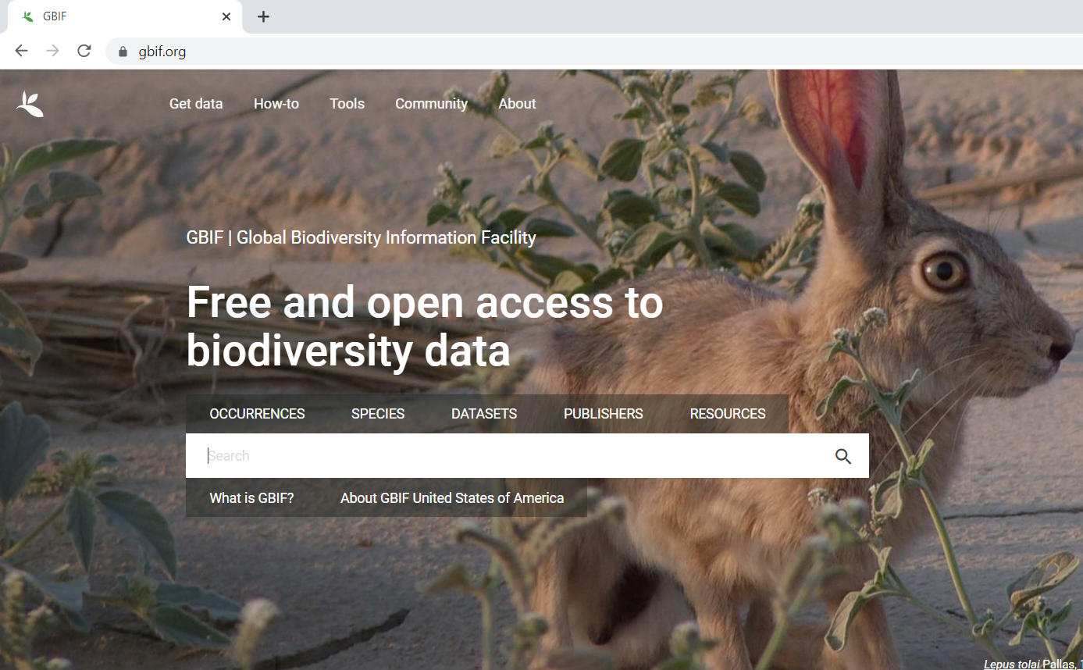
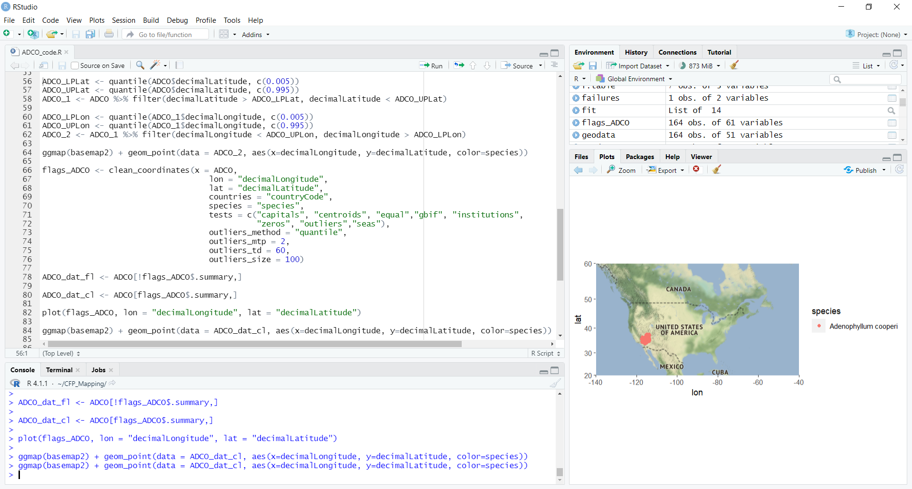
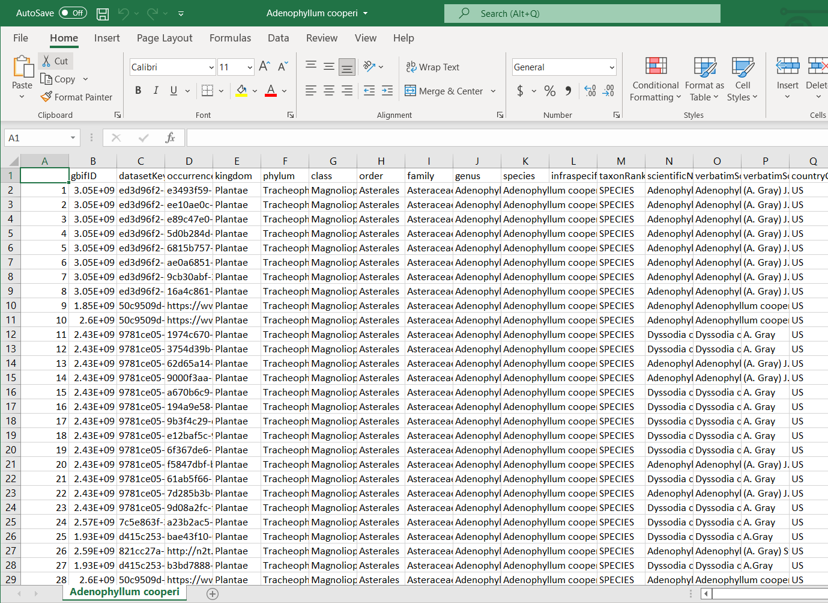
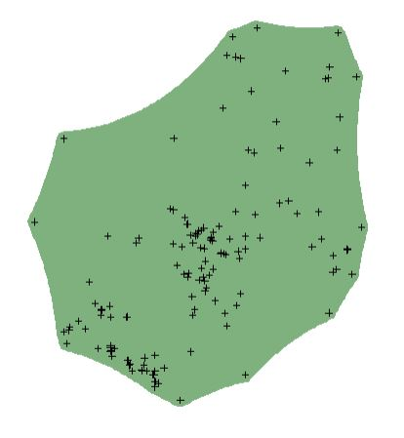
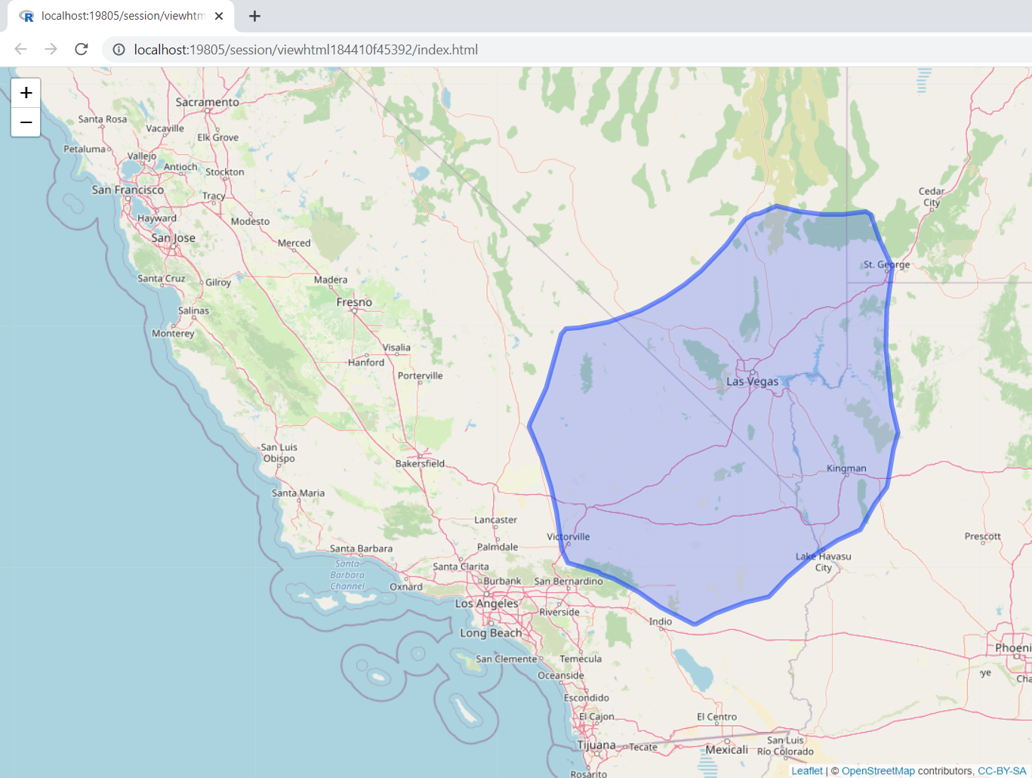
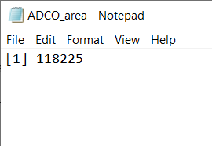
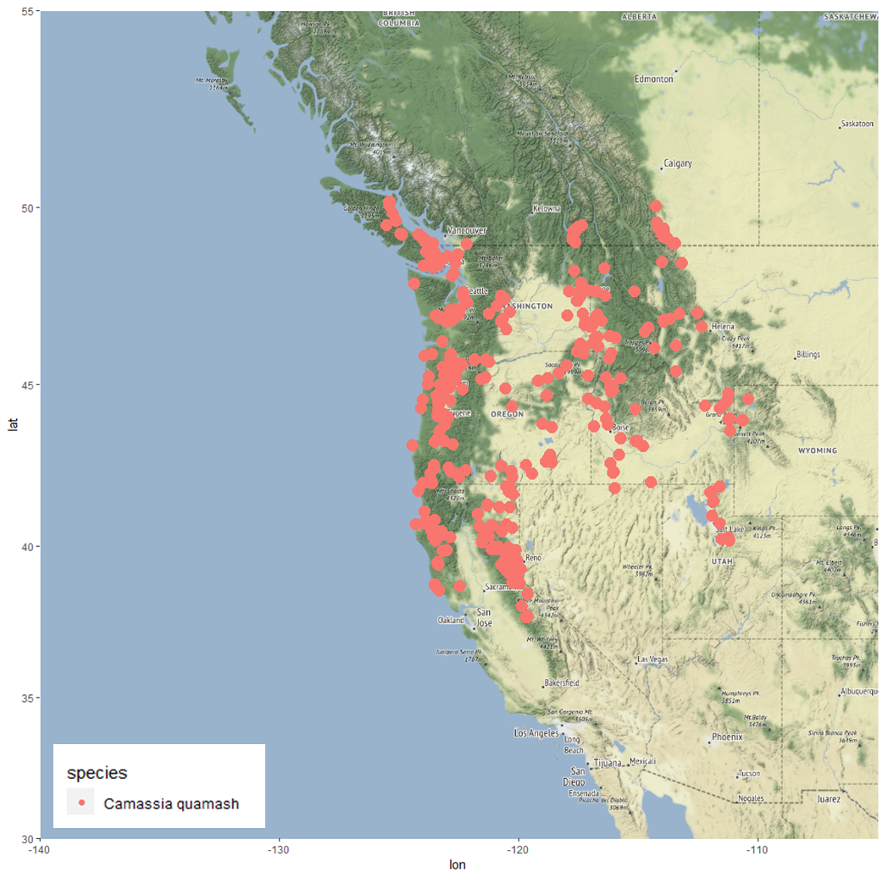
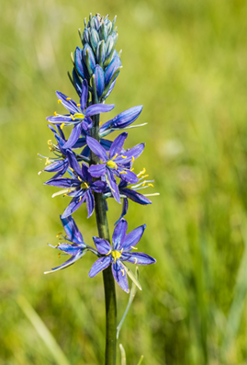
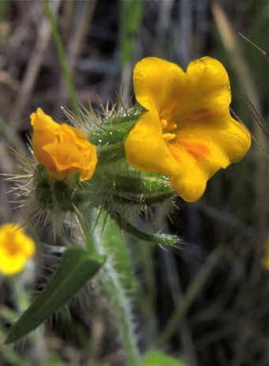
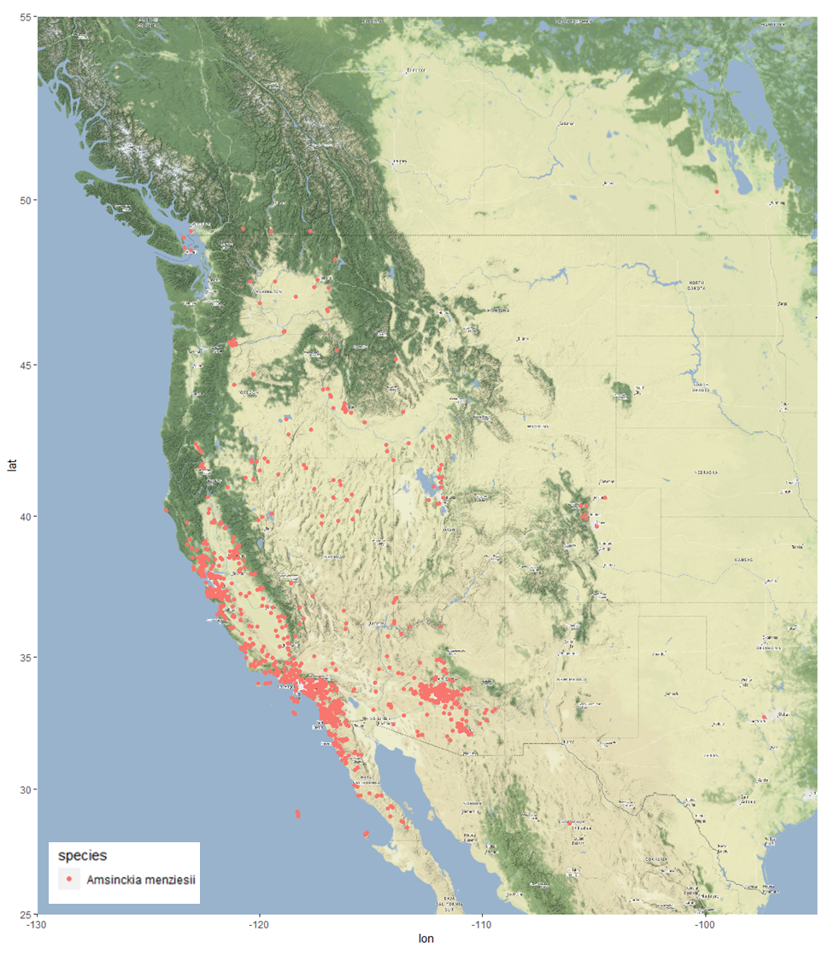
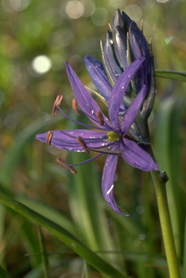
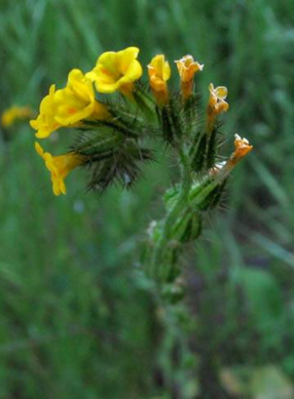
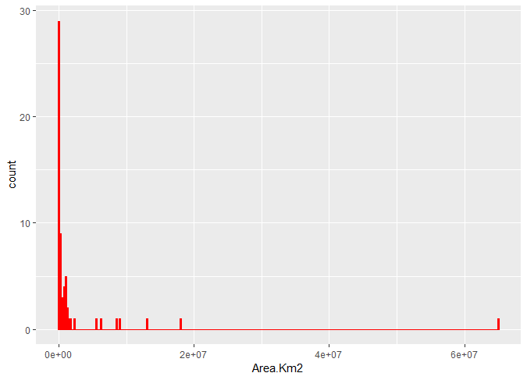
Mapping Species Ranges in the California Floristic Province
Cameron Jones*, Alex Rumbel*, Alexander Hart*, Ava Guillen, Brittany Long, George Sabbagh, Luis Angel Gonzalez, Stephanie Sandoval, Tristan Roach, Victor Garcia Balderas, Zoe Draheim, and Dr. Oscar Vargas. Department of Biological Sciences, California State Polytechnic University, Humboldt, Arcata, CA 95521
What is the California Floristic Province?
The California Floristic Province (CFP) refers to the area of mediterranean climate in the Western United States, which is not strictly bound by the political borders of State of California. Stretching from Southern Oregon to Baja California, Mexico, the California Floristic Province also excludes the Great Basin portion of Southern California, which lies inland of Sequoia National Forest and San Bernardino National Forest. Due to the unique geo-climate, this area is particularly prone to high biodiversity and endemism (Raven and Axelrod 1978)
The exact geographical extent of the California Floristic Province has evolved over the years (Burge and Thorn 2016), and currently there is a suggestion to consider the CFP as containing six formal regions. These six regions of the CFP would be the Northwestern Region (NW), the Cascade Ranges Region (CaR), the Sierra Nevada Region (SN), the Great Valley Region (GV), the Central Western Region (CW) and Southwestern Region (SW), illustrated to the right by Burge and Thorn, et al. in 2016.
Why should we map species in the California Floristic Province?
Mapping species within the CFP has the same advantages as compiling, graphing, and analyzing any other types of data. It becomes much easier to notice patterns. Cleaning the occurrence records of particular species, flagging outliers, and measuring the area of the species range, establishes a body of data which may be helpful in future analyses. Geographic ranges are used to define species’ conservation status as threatened or endangered, and can be used to evaluate the vulnerability of a species to climate change, fire, and human disturbance (Kane et al. 1997).
Methods:
We downloaded occurrence data from the Global Biodiversity Information Facility website (gbif.org)
We created a base R script in Rstudio to map and filter the records based on taxonomic literature. Occurrences were imported as .csv file for every species.
The coordinates from the occurrence data were filtered to exclude
obvious outliers, then ran through the coordinate cleaner package
to exclude records that may be invalid due to a multitude of reasons
(such as being located in the ocean, within a city capital, or being at 0°N, etc…)
A distribution map of the cleaned coordinate data was created, and then a polygon was made to encompass all valid coordinates. The polygon can be seen here with all of the clean points represented by a black cross marks. The polygon was placed over a map to provide context.
The area of the polygon was calculated in square kilometers (km²) and reported as a text file.
The R script, polygon, and polygon area were all uploaded to Google drive.
Results:
Discussion/Conclusion:
Our current data is only made up of 62 species so far, which we plan to complete 300 by the end of the upcoming Fall semester.
Our histogram shows a logarithmic shape, indicating that that only a few species have widespread distributions globally.
Approximately 50% of the species analyzed have ranges smaller that the State of California, and around 20% have areas smaller than Humboldt county.
These results provide direct evidence of the high endemism previously described for the CFP.
Through the use of R, we were able to create multiple maps of species known to be within the
California Floristic Province. While creating the maps we also calculated their distribution size and range, which we can use to create a histogram. The histogram shows that most of the species and their distribution so far have a reasonably small range, such as Ageratina shastensis, which only has a distribution of 480 square kilometers and Trifolium palmeri has a distribution of 512 square kilometers. Given the size of these distributions and the other distribution collected, we can see that most of the data analyzed so far has a limited range and may be considered endemic to the CFP. While most of the distribution is relatively small on a global scale, we do have species within the CFP distributed around the world, such as Juncus bufonius, which has a distribution of 64,909,660 square kilometers according to the data we received from GBIF.
19% of the species analysed so far have a distribution size smaller than Humboldt County.
42% of our species analysed so far have a distribution size between the total area of Humboldt County and the State of California.
34% of the species analysed have a total distribution larger than the State of California, but smaller than the entirety of the United States of America.
5% of the total species analysed have a distribution size larger than the USA
References:
Burge, O et al. (2016) Plant Diversity and Endemism in the California Floristic Province
Kaye, T. N et al. (1997). Patterns of rarity in the Oregon flora: implications for conservation and management.
Raven et al. (1978).Origin and Relationships of the California Flora
Photo credits:
California Academy of Sciences (2004) Camassia quamash, CalPhoto
California Academy of Sciences (2013) Camassia quamash, CalPhoto
Doyen, J. (2016) Amsinckia menziesii, CalPhoto
National Park Services. (2004) Common Fiddleneck, Calscape
*Asterisk denotes lead authors

