Slide 1
Brief agenda for 1 May 2019; 3-4 pm; Corbett Conference Room
HSI STEM Steering Committee
Welcome & Outline for today (3-3:05)
Other brief updates (3:05-3:15)
Staff updates
Task groups…
Focus Gina Garcia’s Visit (3:15-3:35) – Fernando
Steering Input (suggestions)
Where we area…& what’s next (3:40-3:50)
Summer meeting

Slide 2
Garcia, G. A. (2017). Defined by outcomes or culture? Constructing an organizational identity for Hispanic-serving institutions. American Educational Research Journal, 54(1_suppl), 111S-134S.
producing
serving
High
Organizational
outcomes for Latinx
enrolling
enhancing
Low
Low
High
Organization culture
reflects Latinx

Slide 3
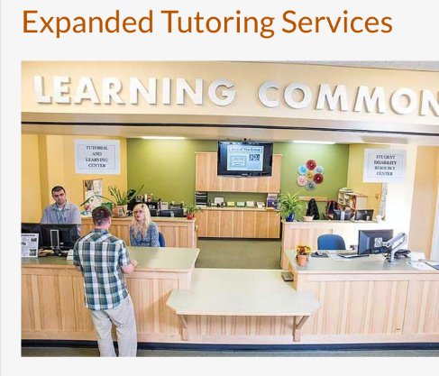
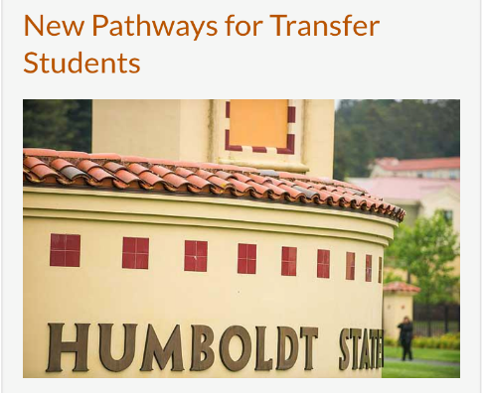
Belonging & Community
Academic achievement
Retention & Graduation
Skills & Attitudes

Slide 4
Latest system-wide 6-yr graduation rate data (5-yr average)
http://asd.calstate.edu/csrde/index.shtml
Campus
STEM Inst
STEM Disc.
44%
48%
33%
19th
15th
8th
5th
39%
38%
22%
Latinx students
21st
17th
10th

